Slide 1

Exploring post-16 Options

Slide 2
RULES ABOUT PATHWAYS AFTER Year 11?
Raising the Participation Age (RPA) :
Young people are now required to remain in either education or training until the age of 18.
This also includes the need to study English and Maths until a grade 4 is achieved

Slide 3
What are your Options?
Apprenticeship (paid employment and training) or Traineeship unpaid work-based skill training and work experience
GCSE
Stay in full-time education, for example, at school, sixth form college or further education college
Spend 20 hours or more a week working or volunteering while also doing part-time education or training

Slide 4
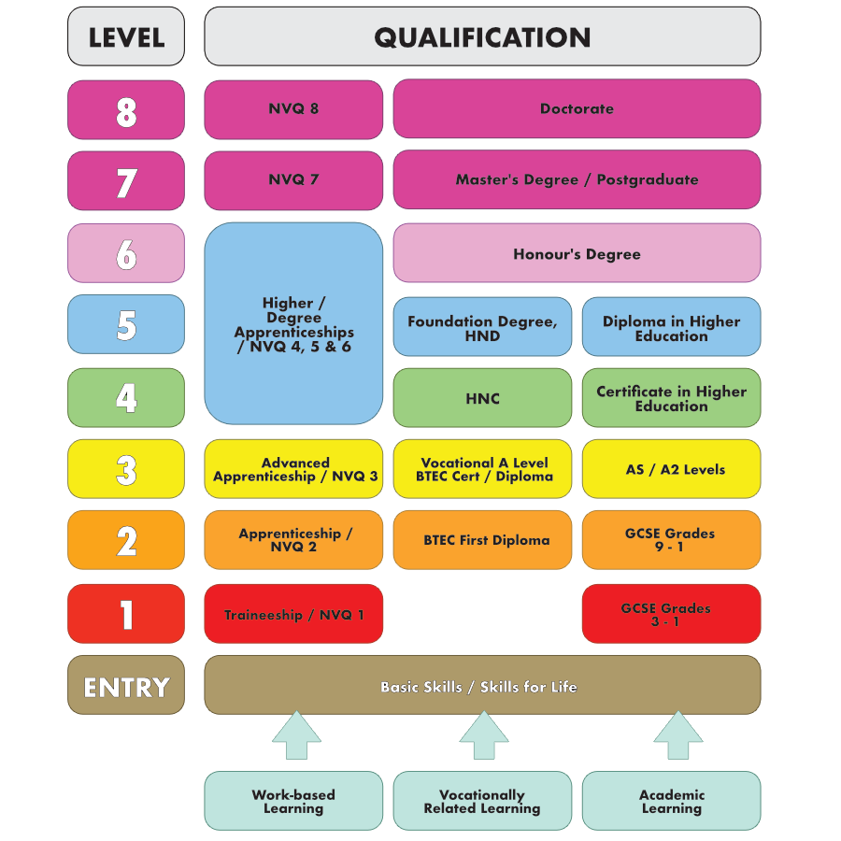
Qualification Levels

Slide 5
SIXTH FORM /
FURTHER EDUCATION COLLEGE
SIXTH FORM:
    Mostly academic subjects at A-level, but some offer BTECs.
    You usually choose 3 or 4 subjects.
FURTHER EDUCATION COLLEGE:
    Mainly vocational qualifications such as BTECs
    Practical and hands-on courses
    Often 3-4 days a week
APPLY AS EARLY AS POSSIBLE
VISIT OPEN DAYS
CHECK WHERE THE COURSE LEADS TO / IS IT THE CORRECT ONE FOR YOU?
CHECK ENTRY REQUIREMENTS FOR COURSES / COMPARE WITH YOUR CURRENT PREDICTED GRADES
NB: A ‘CONDITIONAL OFFER’ MEANS YOU WILL NEED TO GET THE GRADES STATED TO TAKE UP A PLACE ON THAT COURSE.

Slide 6
A LEVELS
Description: Mostly academic subjects. Choose subjects you took at GCSE to study in more depth or pick subjects you may not have done before.
  You could choose 3 very different subjects to keep your career options open or choose closely related subjects if you need them for a specific pathway or career – DO YOUR RESEARCH.
  There is a high degree of independent learning in addition to practical activities for some subjects.
Duration: 2 years
Level of study: 3
Assessment: Mostly exams at the end of the course
Entry requirements: Typically, 5 GCSEs grade 9-5 (usually including Maths and English)
Leads to: University or college courses, higher and degree apprenticeships, employment
https://ucas.com/further-education/post-16-qualifications/qualifications-you-can-take/levels

Slide 7
BTEC QUALIFICATIONS
Description: These courses are more practical and vocational based and are a viable alternative to more theory-focused courses. You will study subjects in relation to how the skills would be used in employment.
Types of Btec: Btecs are very flexible and can be studied at various levels, each of which equates to a different qualification:
        Level 1 and 2 = equivalent to GCSEs
        Level 3 = equivalent to A levels
        Level 4 and 5 = equivalent to 1st and 2nd year of an undergraduate degree
Assessment: For each Btec you complete a series of units – some core, others optional – which are assessed. For each unit, you receive a Pass, Merit or Distinction.
NB: Btecs are offered at many sixth form centres and FE Colleges. At sixth form centres it is possible to study a combination of Btecs and A levels, but at an FE College you will only study one full-time course.

Slide 8
T LEVELS
Description: Designed in partnership with employers to give you the skills and knowledge to get on in the workplace. T levels combine classroom learning with real work placements.
Qualification level: Level 3: One T level is the equivalent of 3 A levels.
Duration: 2 years
Assessment: Exams, projects and practical assignments
Entry requirements: Course dependent
Work experience: At least 45 days on industry placement
Find out more: https://www.tlevels.gov.uk/students

Slide 9
VOCATIONAL AND TECHNICAL QUALIFICATIONS
Description: These courses teach you the practical skills and knowledge for a particular career sector and job. They can prepare you for a broad employment sector, or for a specific job. These qualifications teach you how to do tasks specifically related to the industry and role you want to be involved in.
Duration: 1 or more years
Assessment: Can include coursework, skills tests and exams
Level of study: 1+
Entry requirements: Course dependent
Work experience: You’ll learn in real life situations, for example in a college restaurant or salon that is open to the public. You may also go out on a work placement with an employer.
Find out more: Speak to a local college or training provider.

Slide 10
Apprenticeships
Description: Intermediate, advanced, higher and degree apprenticeships combine practical on-the-job skills training with off-the-job learning. You’ll get training that is relevant to your job and be paid a salary.
Location: You will spend 80% of your time in the workplace and 20% off-the-job with some study in a college, training centre or Institute of Technology.
Duration: Minimum of 1 year
Entry requirements: Dependent on the industry, job role and apprenticeship level
Qualifications: apprenticeship certificate, diploma, degree and masters degree depending on level
Find out more: https://www.apprenticeships.gov.uk

Slide 11
Traineeships
Description: A course that includes work placement that will get you ready for an apprenticeship or a job. You will get work experience and you can also improve your Maths and English.
Location: You will spend a minimum of 70 hours in a work placement with the rest of your time in a college or a training centre.
Duration: 6 weeks to 1 year
Entry requirements: You must be aged between 16-24 or up to 25 with an EHCP, with no higher than a level 3 qualification.
Qualifications: English, Maths, digital and work-related qualifications
Find out more: https://www.gov.uk/find-traineeship

Slide 12
How will I make the right decision?
You can apply for more that 1 post-16 option. Make sure you have always a back-up plan
Choose an appropriate level of course that allows you to progress from your current level and suits your skills and helps you on the pathway to the career you aspire to
Choose the best provider and a place that will support and nurture you
Check your progress against the required entry qualifications.
Have a back-up plan in case you do not achieve the grades you need.
DO YOUR RESEARCH AND APPLY AS EARLY AS POSSIBLE

Slide 13
Help and guidance
Support and advice and guidance is available. You can speak to or contact:
        Your tutor
        Year Leaders
        Pastoral Support
        Subject teacher
        Parents and family members
        Online websites
        Mrs Curtis - Careers Co-ordinator (LRC Office) – to book a meeting email: Angela.Curtis@sirharrysmith.cambs.sch.uk
Aim for the HIGHEST LEVEL of qualification you can and match this with the right course

Slide 14
How should I prepare?
DO YOUR RESEARCH: The right decision is easier if you are FULLY informed and have done your research.
Take time to look at the options and opportunities available.
Research careers, pathways and options:
      School careers library
      Useful websites listed on Year 11 noticeboard, SHSCC website and in the Library
      National Careers Service website
      Look at prospectuses
      Go to open days
Check your performance – know your predicted grades, and know what grades you need to get onto your course or what the apprenticeship provider is asking for
Talk to parents and family
Talk to teachers

Slide 15
Types of qualification: questionS to ask
What qualification I am working at now and what will I achieve by the end of Year 11?
What grades do I need to get onto the course I want ?
How will the course help me progress towards the career I want?
How do I know which type of course will suit my ability and skills?
Remember: Every grade at GCSE counts

Slide 16
Future focus
…. The more you know about yourself, and what options are available, the more likely you are to succeed in your future career

Slide 17
Remember: gcse grades matter!
On average, people with 5 GCSEs at grade 4 or above earn 7% more an hour than those with grades below
25% of young adults without grade 4s at GCSE are unemployed (compared to just 16% of those with grades above)
THE BETTER YOUR GCSE GRADES, THE MORE LIKELY YOU ARE TO FIND WORK AND THE BETTER YOU’LL BE PAID
*2010 study

