Slide 1
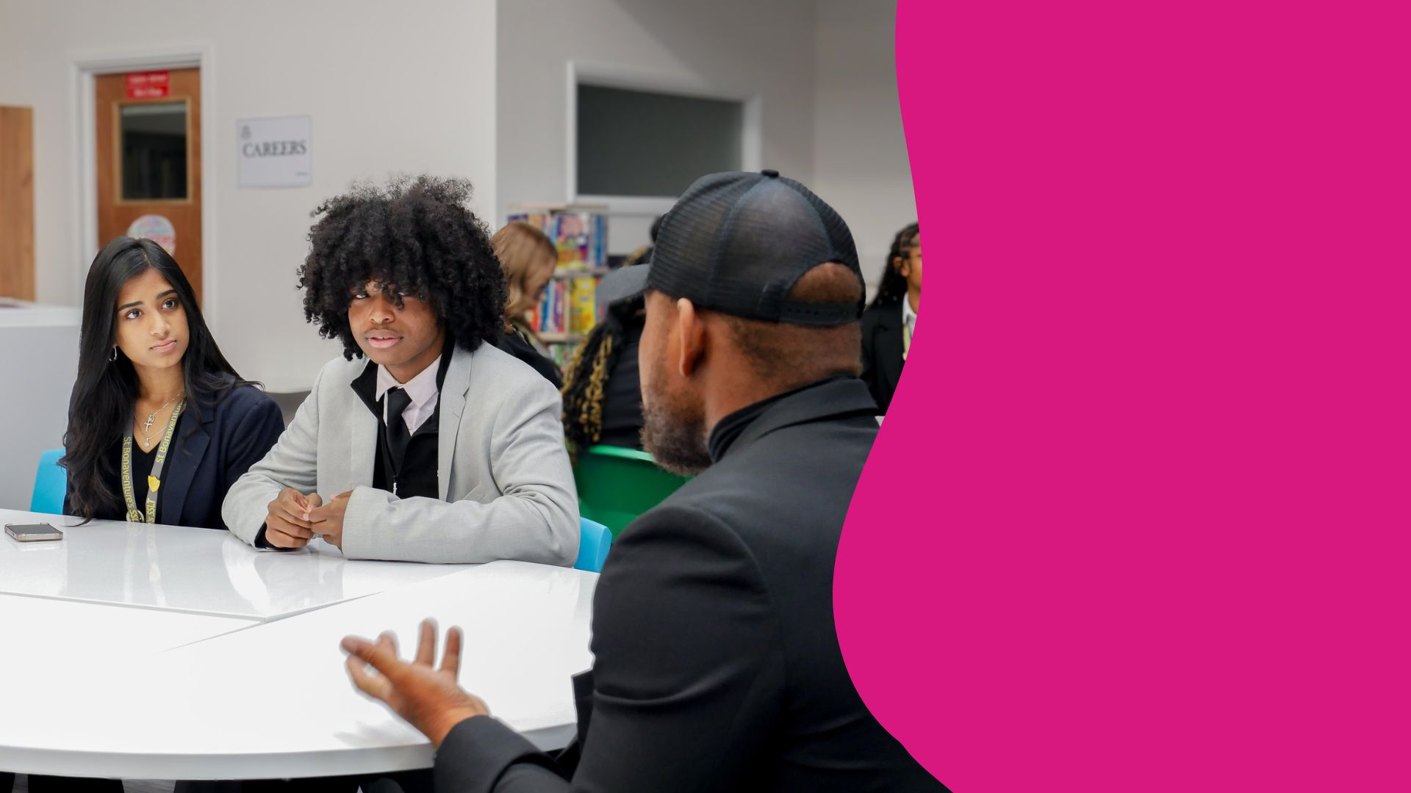
Sir Harry Smith Community College and Future First
Join our network of former students!

Slide 2

SHSCC alumni network
When you finish your exams this summer, we don’t want that to be the last time you’re in touch with our school.
We are working with Future First to help us keep in touch with our former students, also known as ‘alumni’.

Slide 3

Who are Future First?
Future First is a social mobility charity which helps schools like ours to stay in contact with their leavers from day one.
We’ll contact you a few times a year with school news and opportunities to stay involved through volunteering.
Plus we want to hear about your pathways after leaving school!

Slide 4

Why keep in touch?
Stay connected and create a network
Improve your CV by volunteering your time
Inspire students by sharing advice and guidance through your experiences

Slide 5
Become a role model
You could come back and…
Let students know what the first year after leaving school is really like
Share the story of your journey to your current career
Share your career experiences with those who are in your position now

Slide 6
Join the SHSCC alumni community today!
https://www.futurefirsthub.org.uk/register/sirharrysmith
Best of luck and stay in touch!

Slide 7

CONTACT US!

