Slide 1
Welcome to Sir Harry Smith Community College

Slide 2
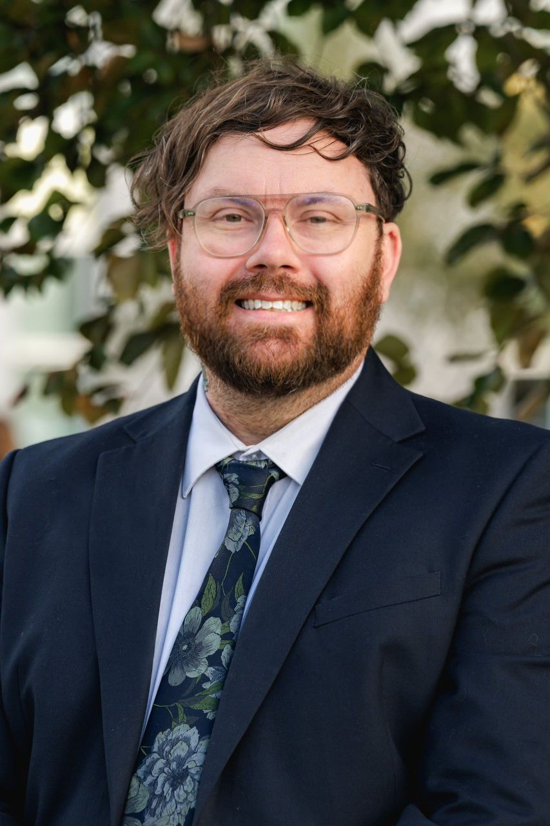
As Acting Headteacher, I want parents and carers to understand what drives my decisions and my vision for our school.
Having worked in education for over 20 years, I believe a great education is about far more than qualifications. It should help young people discover their strengths, develop their character and prepare them for life.
I have high expectations because I believe every child is capable of achieving great things. But those expectations must go hand in hand with care, consistency and compassion, so every student feels both challenged and supported.
Above all, schools are communities. When students, staff and families work together, we give young people the best possible opportunity to succeed.
My commitment is simple: to build a school where every child feels known, valued and inspired to be their best.

Slide 3
"I believe schools should help create good people, not just successful students."

Slide 4
Putting Pupils First
Every decision should focus on improving outcomes, experiences and opportunities for our students.
Stronger Accountability & Visibility
Clearer responsibilities help us identify priorities quickly and take effective action.
Improved Communication
We want parents and carers to feel heard, with stronger communication between school, families and the wider community.
Greater Leadership Capacity
Our structure gives senior leaders more capacity to focus on teaching, behaviour, attendance, safeguarding and staff development.
Long-Term Stability
Clear systems, shared expectations and sustainable leadership will support lasting school improvement.
Listening to Our Community
We value feedback from parents and carers and will consider it carefully when making decisions in the best interests of our students.

Slide 5
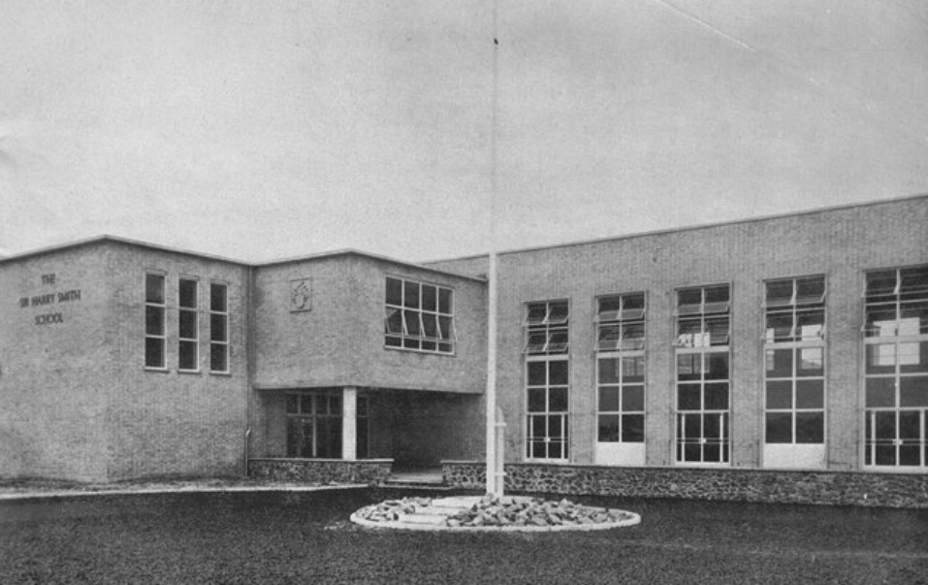
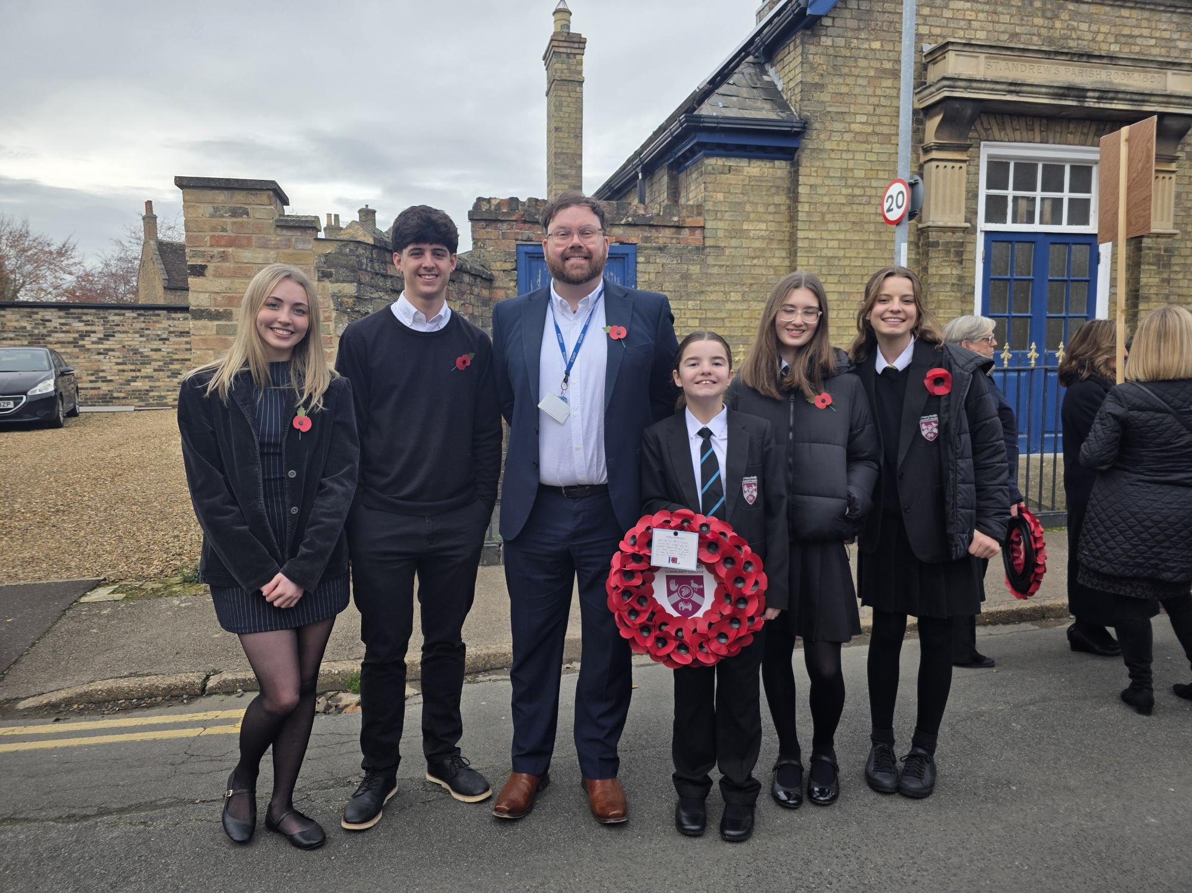
Communication
Community & Collaboration
Accountability
Safety
Attendance
Achievement
Enrichment
Aspiration & Achievement
Be Safe
Be Respectful
Be Responsible
Be Proud
1953
2025

Slide 6
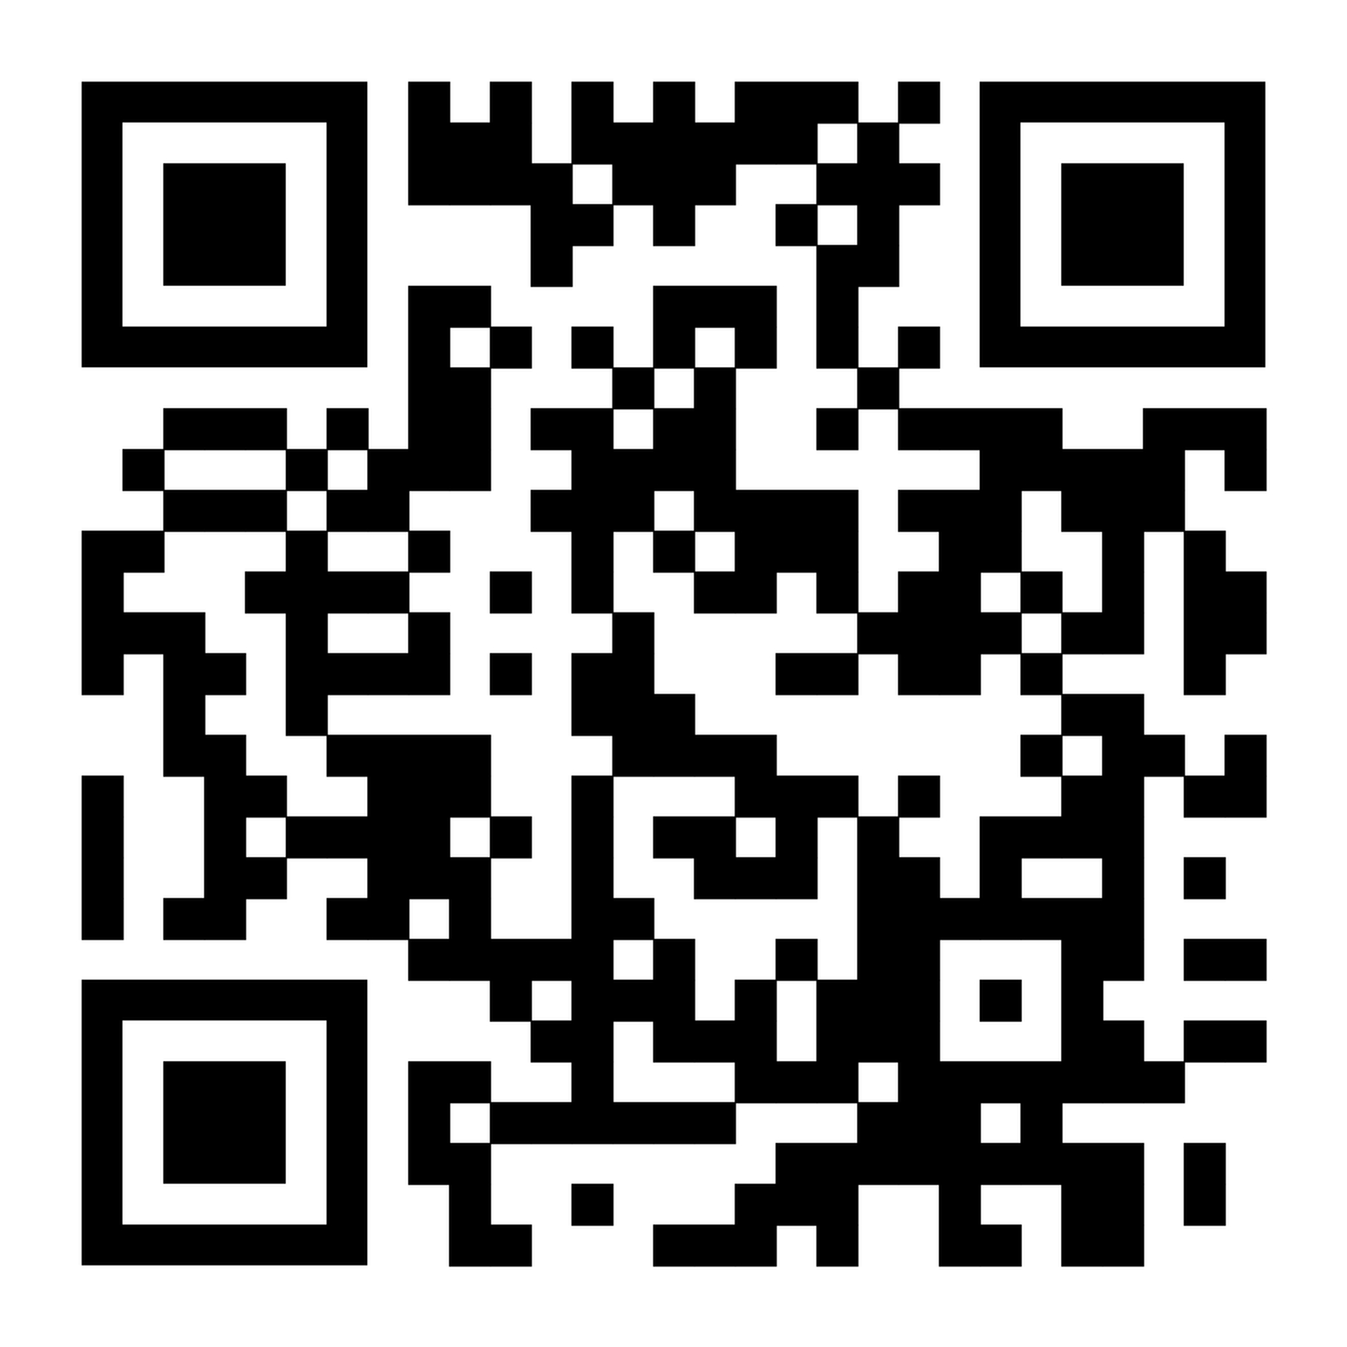
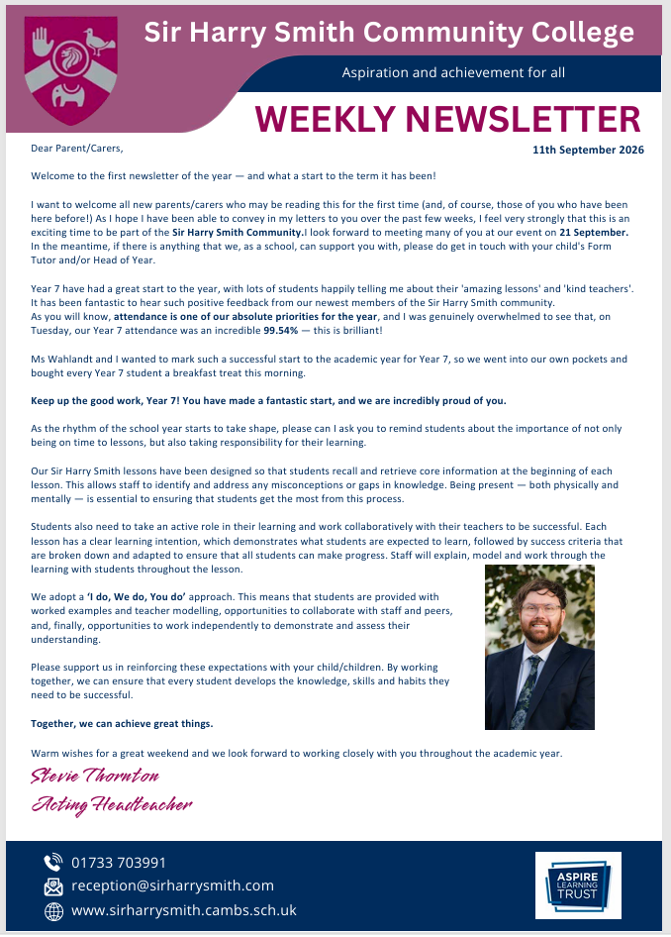

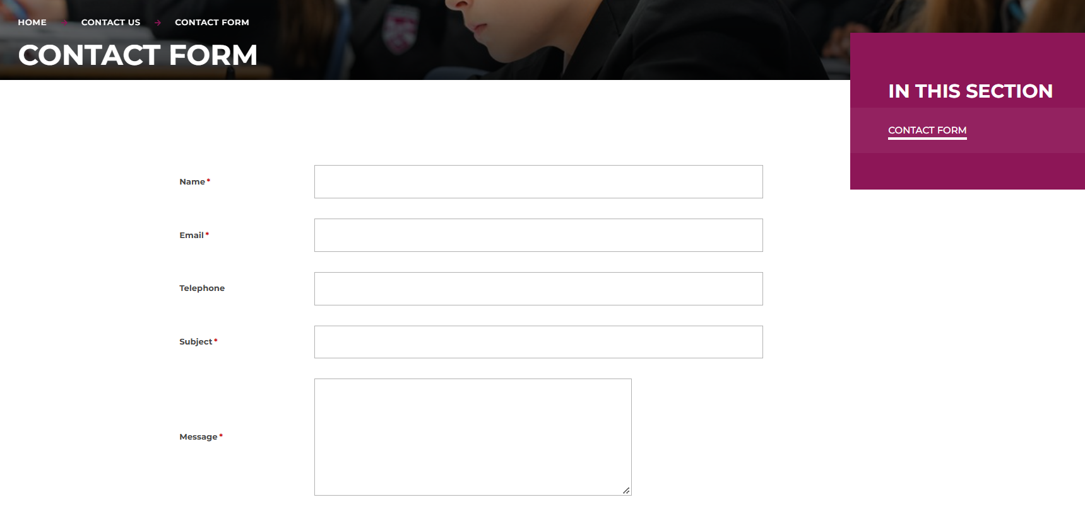
School ID = SHSCC
Our staff may occasionally send emails outside of normal working hours. However, there is no expectation for staff to read or respond to emails outside of their normal working hours.
Parent enquiries will be responded to during working hours, Monday to Friday, during term time only, and we aim to respond within 48 hours.
Thank you for your patience and understanding.

Slide 7
Methods of communication
Administration issue such as ParentPay or missing uniform
reception@sirharrysmith.com
General SEND issues/enquiries
chodgkin@sirharrysmith.com
Specific SEND issues/enquiries
General enquiries (not specific)
Specific staff
reception@sirharrysmith.com
General or specific KS5 issue/enquiry
Pastoral issue (general)
Child’s form tutor
crestaino@sirharrysmith.com
Pastoral issue (specific/ongoing/serious)
Attendance issue/enquiry
Child’s HOY
kmaddy@sirharrysmith.com
General or specific classroom issue/enquiry
Safeguarding issue/concern
Individual teacher
cpteam@sirharrysmith.com
Progress concerns/staffing concerns/academic support
FAO Mr Thornton
cmeadows@sirharrysmith.com
Curriculum Manger or HOD

Slide 8
Complaints Procedure: A Quick Guide for Parents and Carers
We want to work with you
At Sir Harry Smith Community College, we welcome feedback and aim to resolve concerns quickly, fairly and respectfully. We encourage parents and carers to raise any issues as soon as possible.
Concern or complaint?
A concern is a worry or question where you’re seeking clarification or reassurance.
A complaint is an expression of dissatisfaction about an action, decision or lack of action.
Step 1: Raise your concern
Contact the member of staff most closely involved. Most concerns can be resolved quickly through an informal discussion.
Step 2: Make a formal complaint
If the issue remains unresolved, complete the Trust’s Complaints Form. Complaints should normally be raised within three months of the issue occurring.
Step 3: Request a panel review
If you’re dissatisfied with the formal response, you can request a review by an independent complaints panel. The panel will consider whether your complaint was handled fairly and in line with the policy.

Slide 9
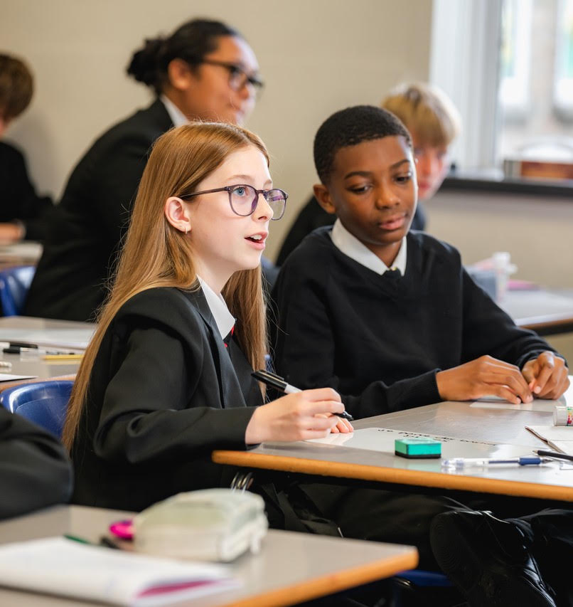
Our Commitment
We will listen, treat everyone with respect and investigate concerns fairly. We’ll maintain confidentiality where appropriate, make reasonable adjustments and aim to resolve issues as quickly as possible.
Complaints About Senior Leaders or Governors
Complaints involving the Headteacher, CEO, Governors or Trustees follow separate routes to ensure they are handled independently and fairly.
What Isn’t Covered?
Some matters follow separate procedures, including:
Admissions appeals
Pupil exclusions
Safeguarding and child protection
Whistleblowing
Complaints about external organisations using school facilities
Our Aim
We aim to resolve concerns early, build positive relationships with families and ensure every complaint is handled fairly and professionally.

Slide 10
Stevie Thornton
Strategic direction
Governance
Communications
Ofsted strategy
Staff recruitment & retention
School finance
Performance management
Teaching & Learning strategy
Whole school curriculum
PSHE/RSHE/online safety (with RI)
Assessment, recording & reporting (with RA)
Cover
Staff wellbeing
ECT (Naomi B)
Anna Wahlandt
DSL/safeguarding strategy
Single Central Record
Attendance/punctuality/admissions
Behaviour overview & pastoral lead line manager (FT & AR)
Inclusion – SEND/CIC/AP/ALG
Parental engagement
Assemblies (with FT & AR)
Helen Cassady
SLT support and guidance
QA of Attendance (with AW)
Attendance data analysis
QA of T&L/Curriculum
Frances Light-Rudland
Trust Head of Inclusion/SEND
SENCO
Paul Treliving
Aspire Awards (with TS)
Parent Evening & whole college events
Premises
Health & safety
Emergency procedures
Cultural Capital/Enrichment benchmarks (with DT)
Tutor time
Detentions
Tim Smith
DDSL (pending completion)
Head of 6th Form
Raising standards – KS5
Destinations
Aspire Awards (with PT)
Careers
PP/Disadvantaged strategy (with TH)
Whole school exams
Duty rota
Tom Holland
Raising standards – KS4
Year 9 into 10 pathways
Timetable
PiXL lead
PP/Disadvantaged strategy (with TS)
Luke Nichols
T&L lead
ALG & SEND support
Steplab/QA (with EG)
Darryl Tomlin
T&L lead
Cultural Capital/Enrichment benchmarks (with PT)
Educational visits
Rehana Ibrahim
Tutor time (with PT)/PSHE/RSHE/online safety (with ST)
Literacy strategy (Ash G)
Rachel Atkins
Assessment, recording & reporting (with ST)
Middle Leader development
ITT
Y6 – Y7 Transition
Claire Cutler
T&L lead (specific focus on KS5)
Student voice
Adam Curtis
Gifted & Most able strategy
Cover supervisors/Supply staff
Mark Crane
Raising standards – KS3
AI advisor

Slide 11
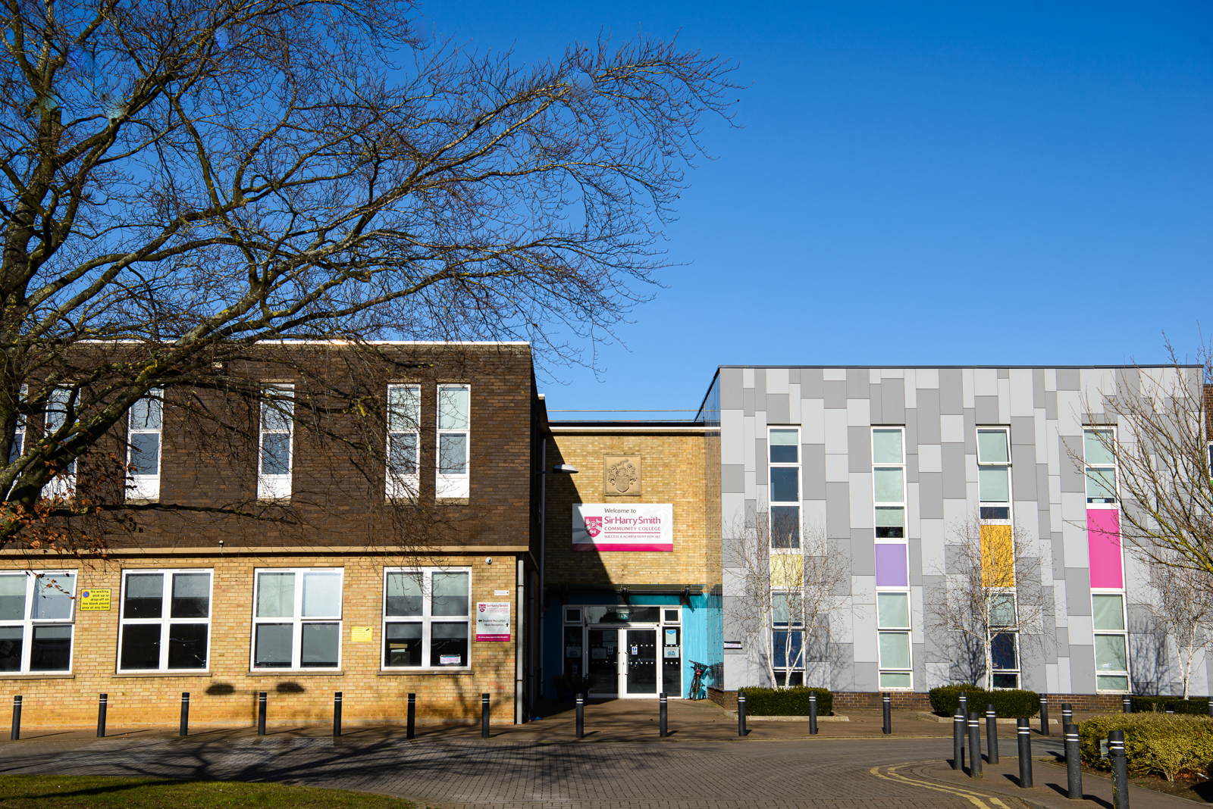
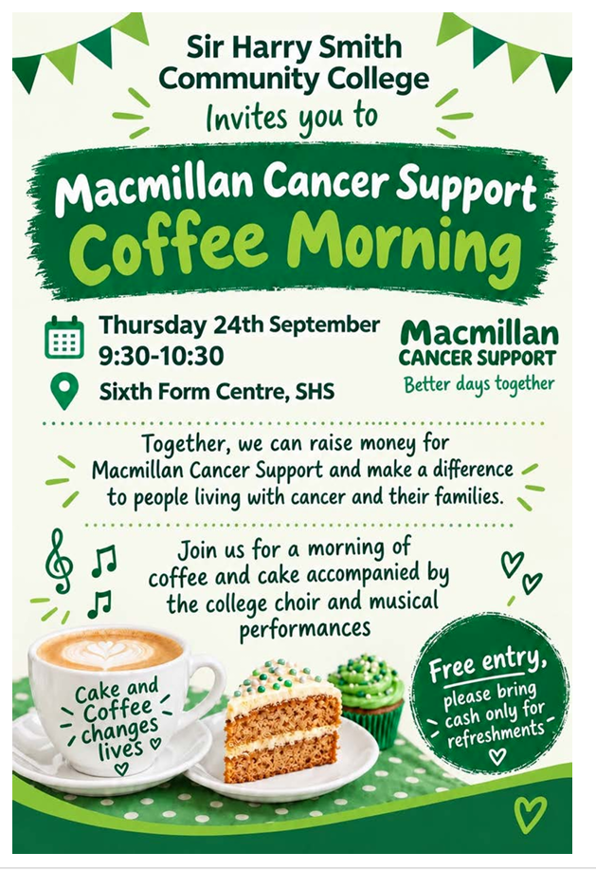
Community & Collaboration
Parent Forum
Our Parent Forum meets each half term to support college improvements and communication.
We’re always looking for new parents and carers to join us – refreshments provided!
Contact Ms Meadows for more information.
Headteacher’s tour
From Friday 16 October, parents, carers and prospective families can book a one-hour tour of the college.
Tour classrooms and facilities, meet staff and students, and ask any questions you may have.
Tours must be booked in advance with Ms Meadows.
Suggestions?
Have an idea to support our renewed focus on community engagement? We’d love to hear it.
Email suggestions@sirharrysmith.com. Suggestions are reviewed monthly by SLT.

Slide 12
Autumn
15/09 – Y11 Information Evening
15/09 – KS5 Information Evening
21/09 – Parent/Carers Evening
22/09 – UCAS information evening
24/09 – Y7 Welcome Evening
06/10 – Y6 Open Evening
20/10 – 6th Form Open Evening
19/11 – Y8 Parents Evening
03/12 – Y9 Parents Evening
Spring
05/01 – Y11 Parents Evening (1)
12/01 – Y9 Guided Choices/Options
21/01 – Y10 Parents Evening (1)
11/02 – Y13 Parents Evening (1)
25/02 – Y7 Parents Evening
23/03 – Y12 Parents Evening
Summer
22/04 – Y11 Parents Evening (2)
27/04 – Y13 Parents Evening (2)
24/06 – Y10 Parents Evening (2)
06/07 – Award's Evening
Increased parent evenings/information throughout the academic year
In addition, there will be more Parents’ Evenings, with increased staff attendance and representation from SLT and SEND at each event.

Slide 13
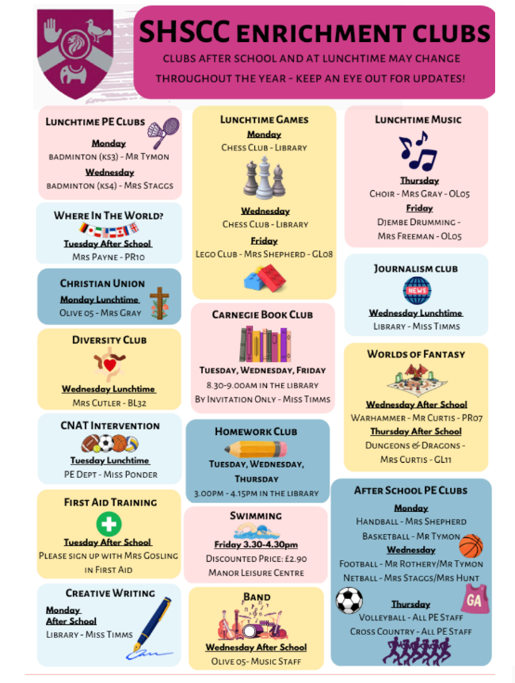
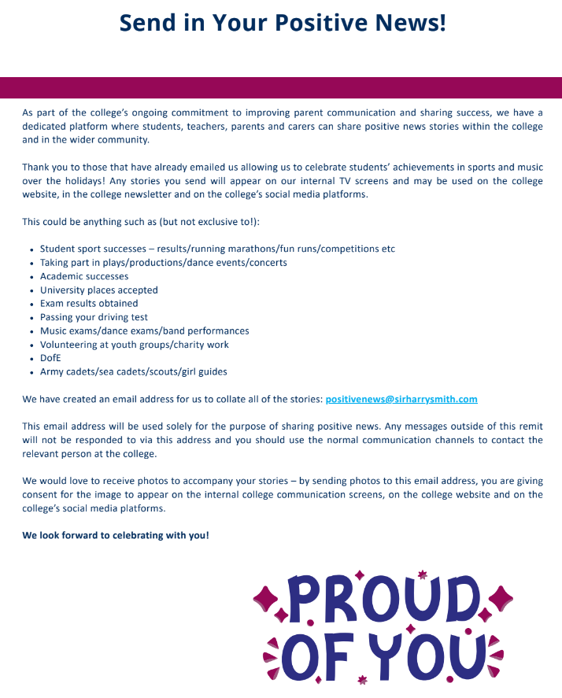
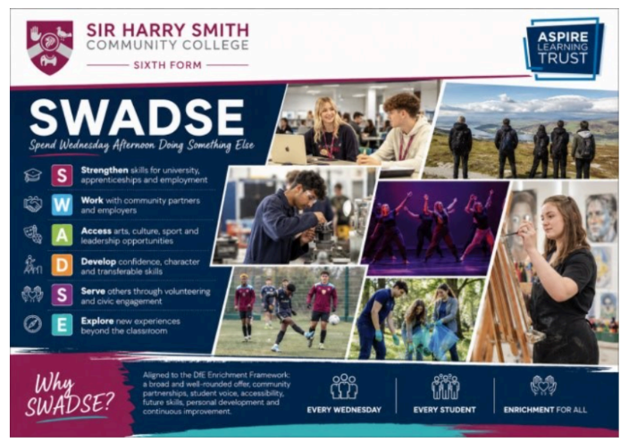
Enrichment: Now

Slide 14
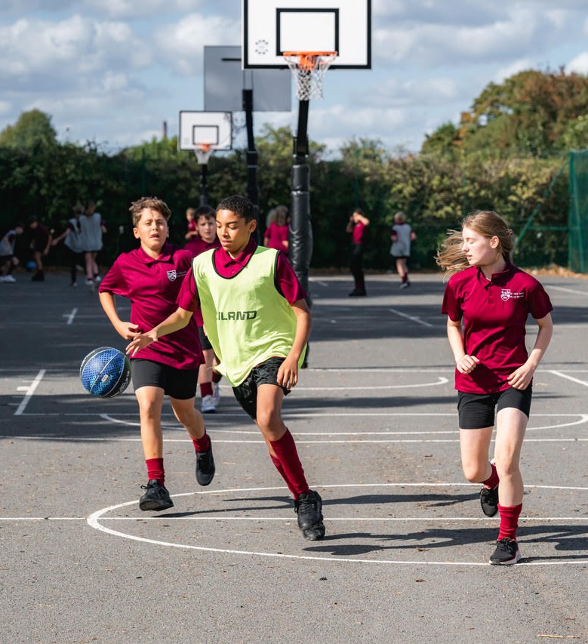
Enrichment: Future
Friday Afternoon Enrichment Programme
From this academic year, all students will take part in a dedicated Friday Afternoon Enrichment Programme with a choice of activities designed to build confidence, skills, interests and aspirations.
Activities will include:
Sport and physical activity
Arts, music and culture
Outdoor learning and adventure
Leadership and community projects
Careers, enterprise and life skills
Academic and special interest clubs

Slide 15
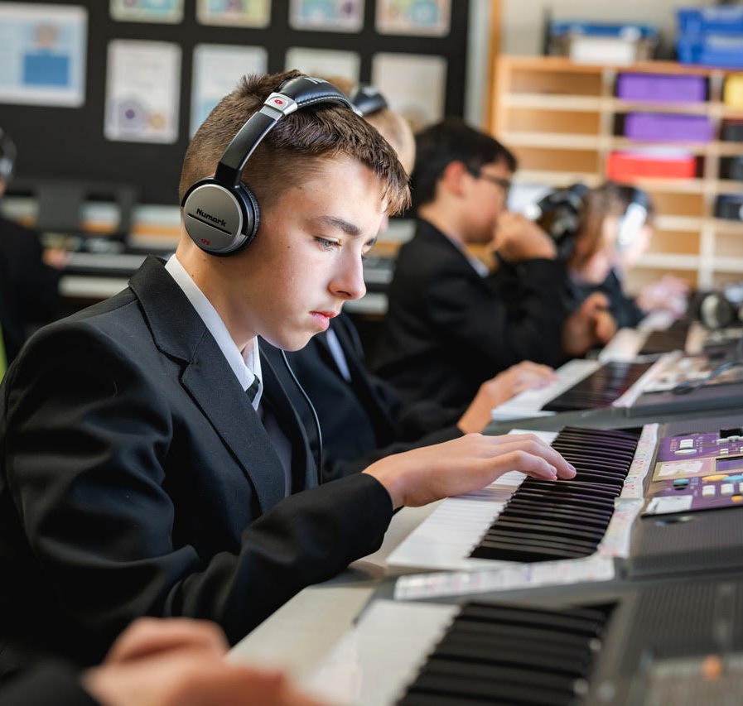
Friday TBC
08.30 – 09.00: Tutor time
09.00 – 09.50: P1
09.50 – 10.40: P2
10.40 – 11.00: Break
11.00 – 11.50 – P3
11.50 – 12.40 – P4
12.40 – 13.30 – P5
13.30 – 14.10 – Lunch
14.10 – 15.00 – Enrichment
NOTE: Y11 offered Study time instead of Enrichment
Our aim is for every student to discover new interests, build skills and friendships, and gain experiences that support their future.
Aligned with the Government’s Enrichment Framework, the programme will take place within the school day, ensuring every student has the opportunity to participate.
Further details about activities and how to choose them will be shared shortly.

Slide 16
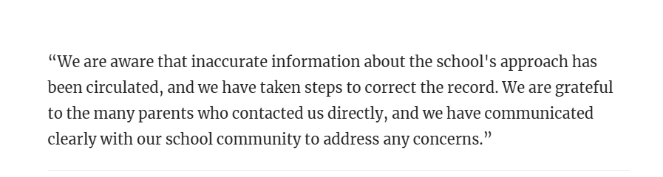
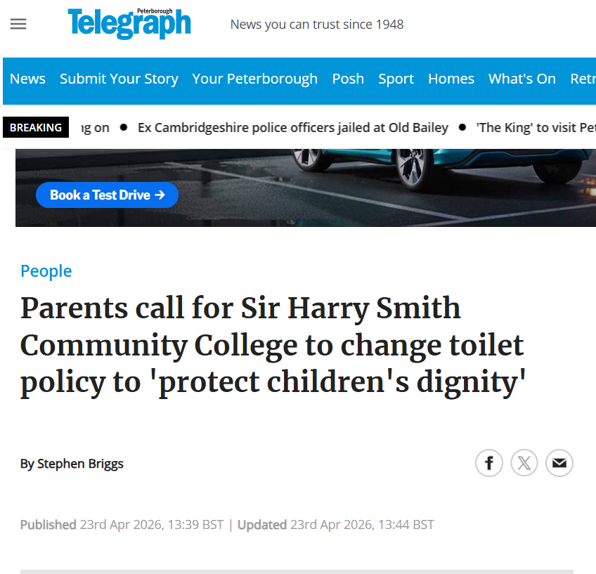
Toilets
Whilst we must have clear expectations and routines, we must also apply them with humanity and common sense. Students should use social times responsibly, while staff will support those who genuinely need access to toilets during lessons.
Our approach will always be based on respect, understanding and student wellbeing.

Slide 17
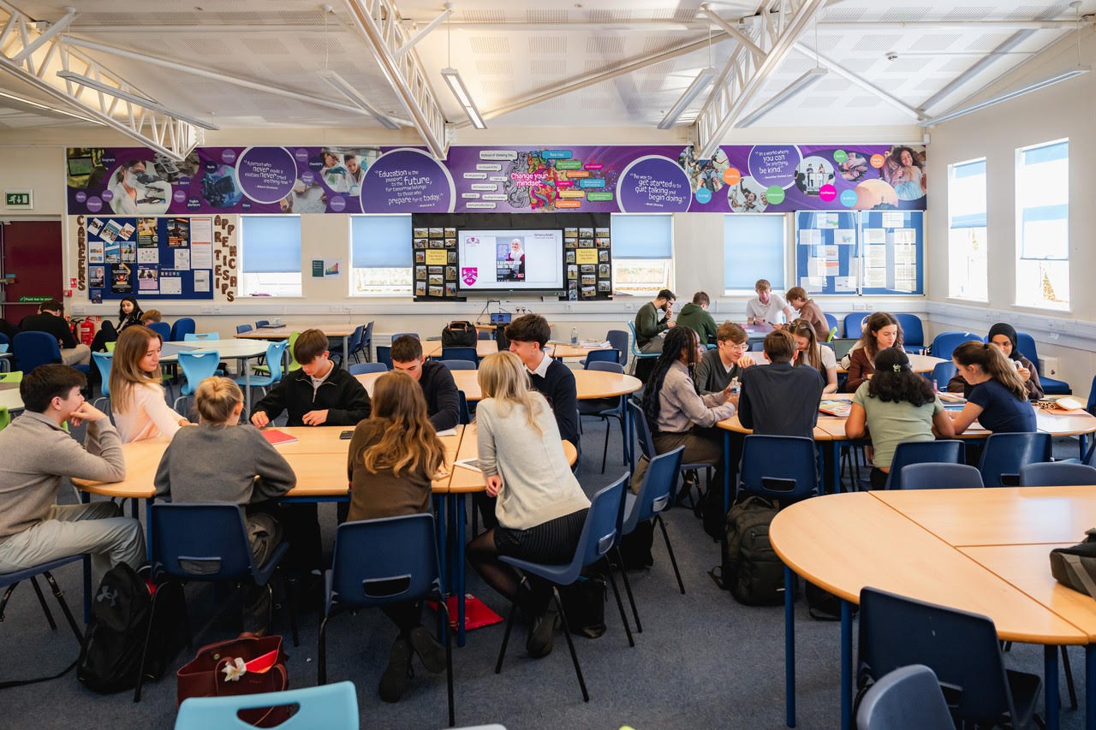
Cover Lessons – ‘Subs’
We’ve strengthened support for external cover staff, including providing laptops to access planned resources and contact staff when needed.
Where possible, KS4 lessons will be covered by SLT or Middle Leaders where cover is unknown.
Curriculum Managers/HODs are responsible for ensuring cover work is accessible and in line with our expectations.

Slide 18
Responsibility – a collaborative effort
Classroom expectations
Stage 1/Remind – Verbal Warning(articulated to student with reason)
Stage 2/Reflect – Second Warning (30-minute detention on Edulink to be set)
Stage 3/Removal – Removal (60-minute detention on Edulink to be set. This cancels out previous 30-minute detention i.e. students ONLY receive a 30-or 60-minute detention, not both)
On-call MUST be called via Edulink at this point. If Stage 3 has been reached, student(s) are to remain in classroom until they are collected by on-call
Aspiration & Achievement
Be Safe
Be Respectful
Be Responsible
Be Proud
In return, we expect students to be in school, on-time, take pride in their uniform, speak with peers/staff with kindness, listen to & follow instruction, take responsibility.
Parents/carers – please encourage your child to attend detentions in order for restorative conversations to be had – this allows both staff & student to be heard & move on

Slide 19
Questions?

