Slide 1

Welcome to
Sir Harry Smith Community College

Slide 2
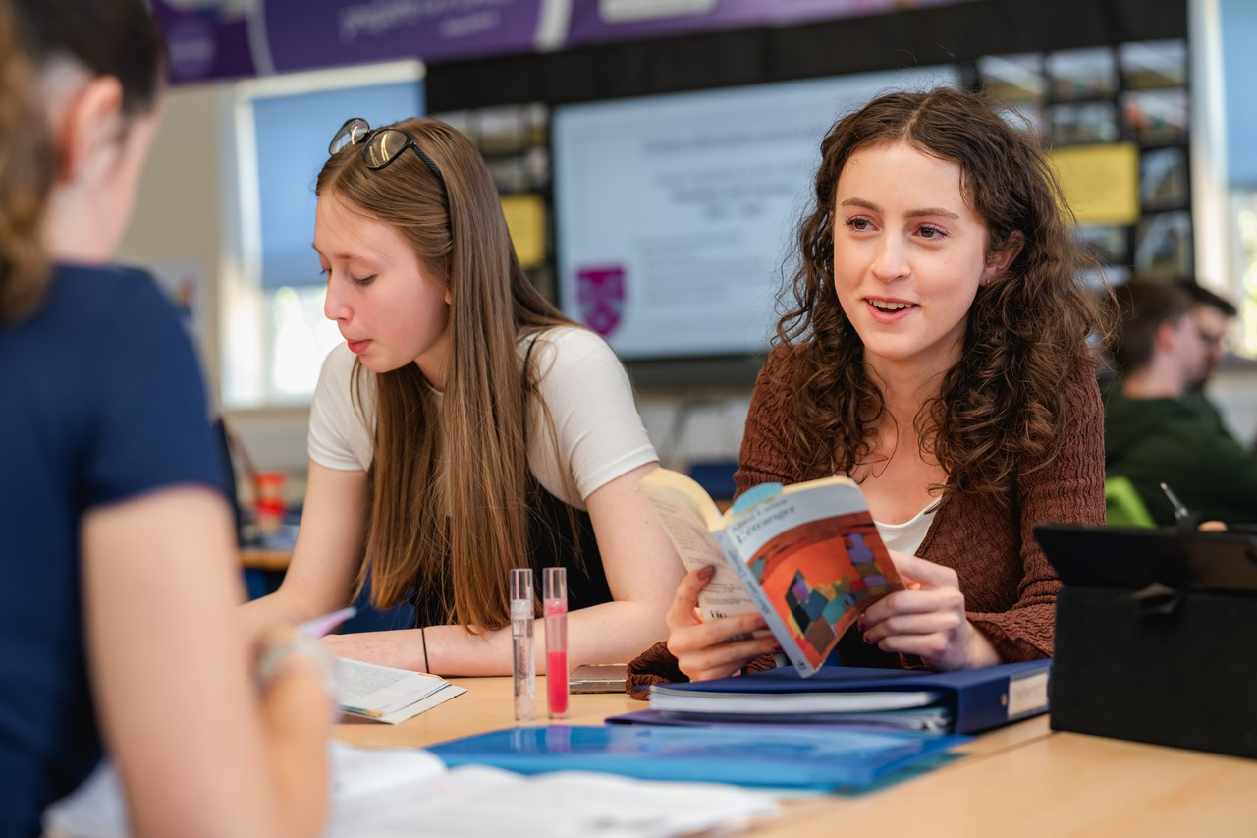
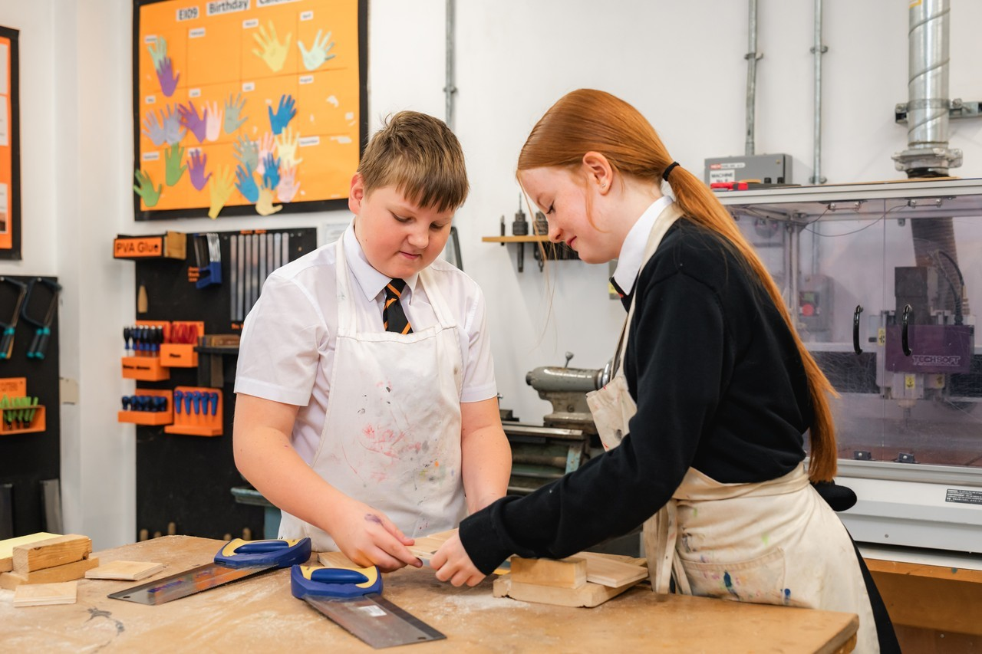
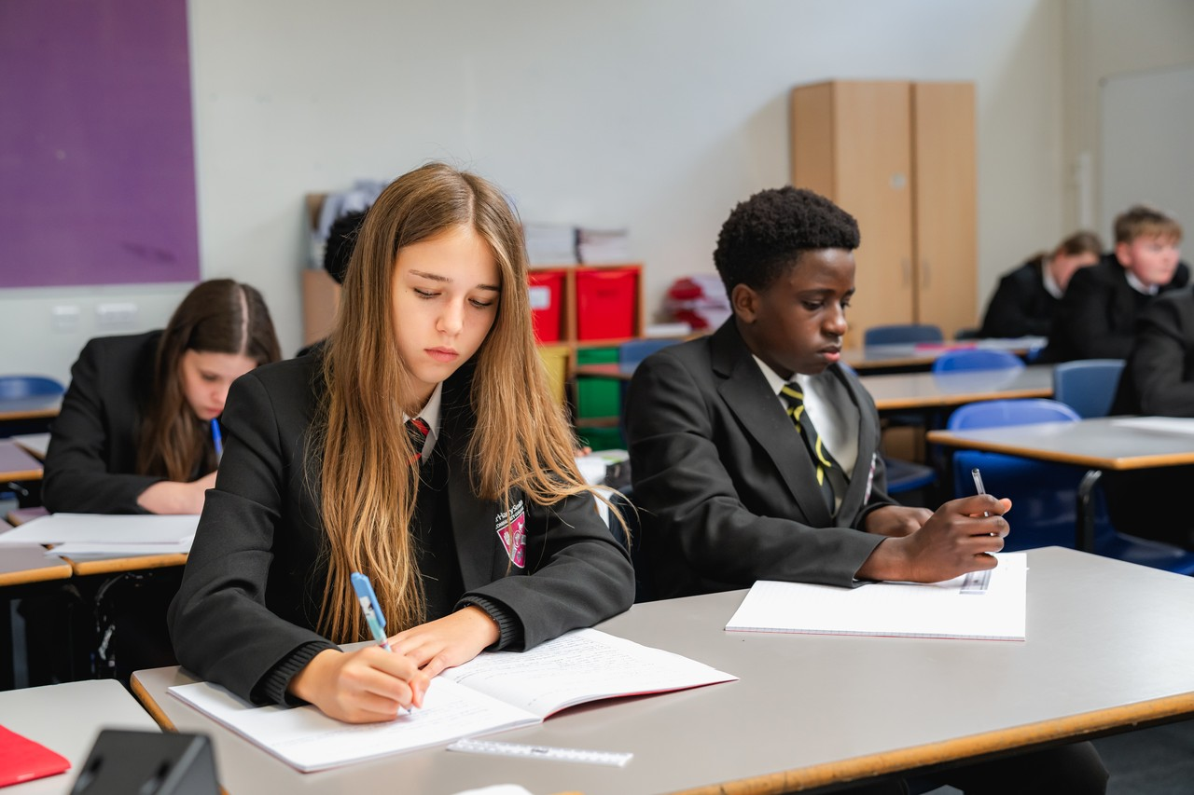
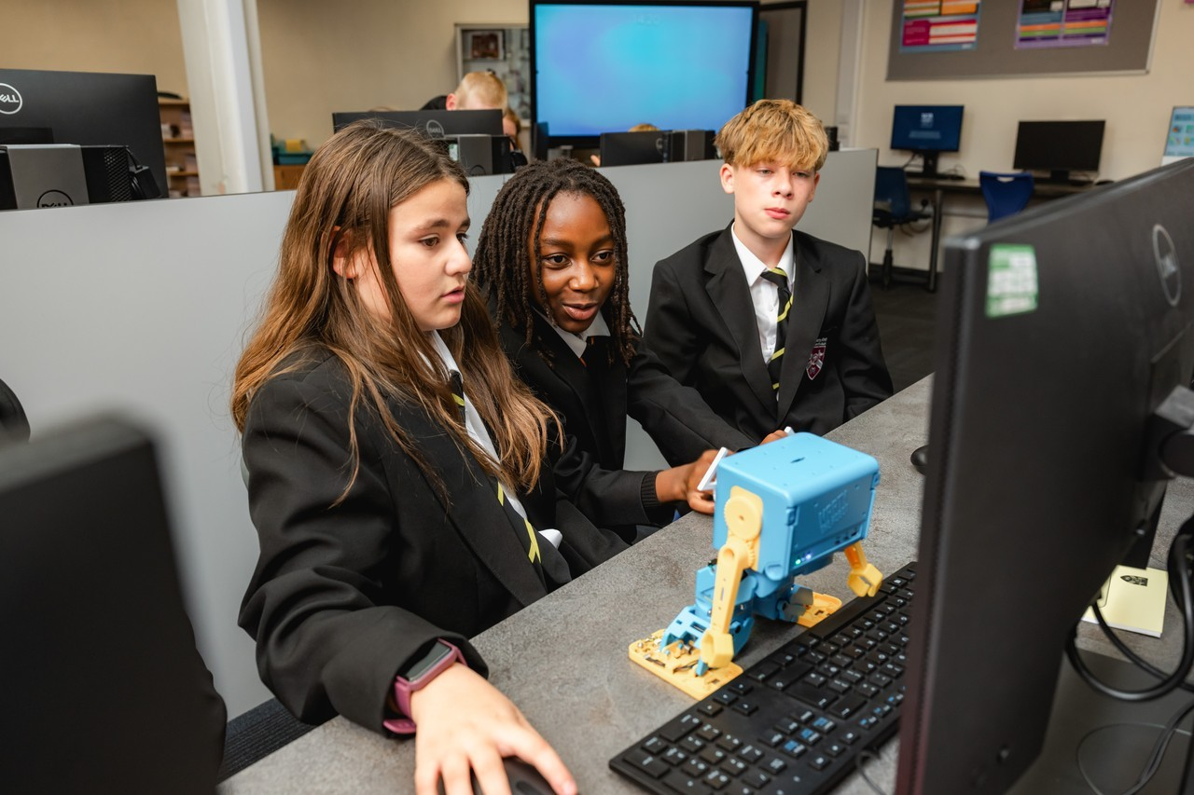
"I believe schools should help create good people, not just successful students."

Slide 3
Putting Pupils First
Every decision should focus on improving outcomes, experiences and opportunities for our students.
Stronger Accountability & Visibility
Clearer responsibilities help us identify priorities quickly and take effective action.
Improved Communication
We want parents and carers to feel heard, with stronger communication between school, families and the wider community.
Greater Leadership Capacity
Our structure gives senior leaders more capacity to focus on teaching, behaviour, attendance, safeguarding and staff development.
Long-Term Stability
Clear systems, shared expectations and sustainable leadership will support lasting school improvement.
Listening to Our Community
We value feedback from parents and carers and will consider it carefully when making decisions in the best interests of our students.

Slide 4
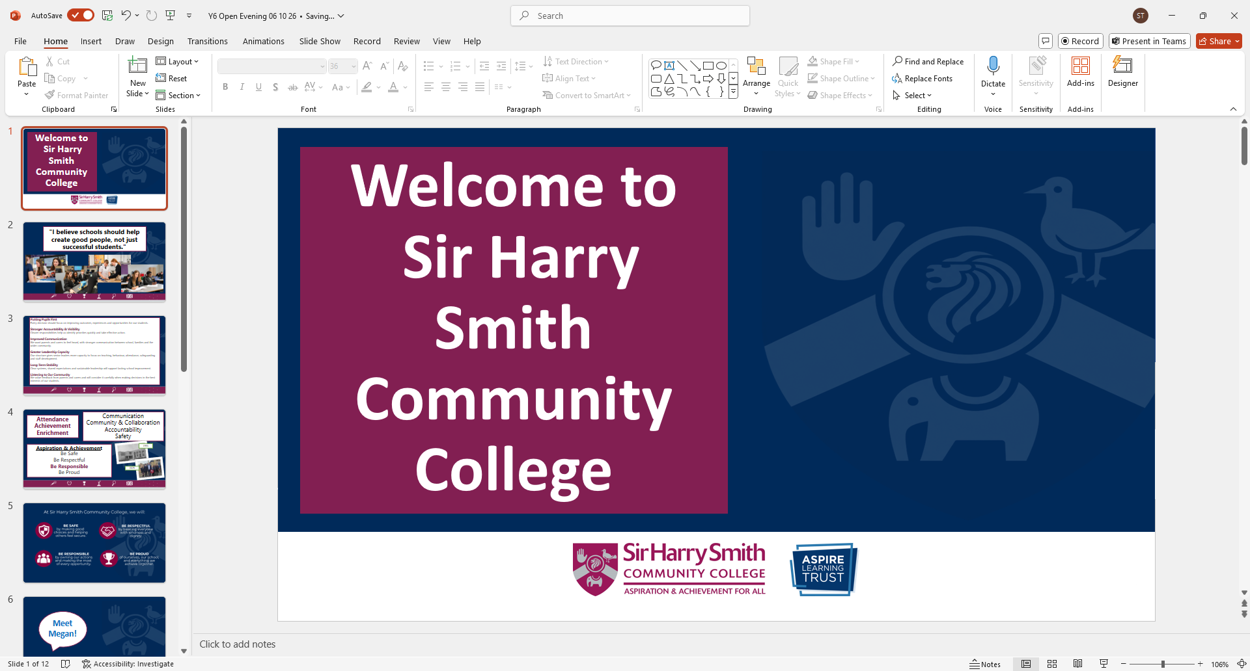
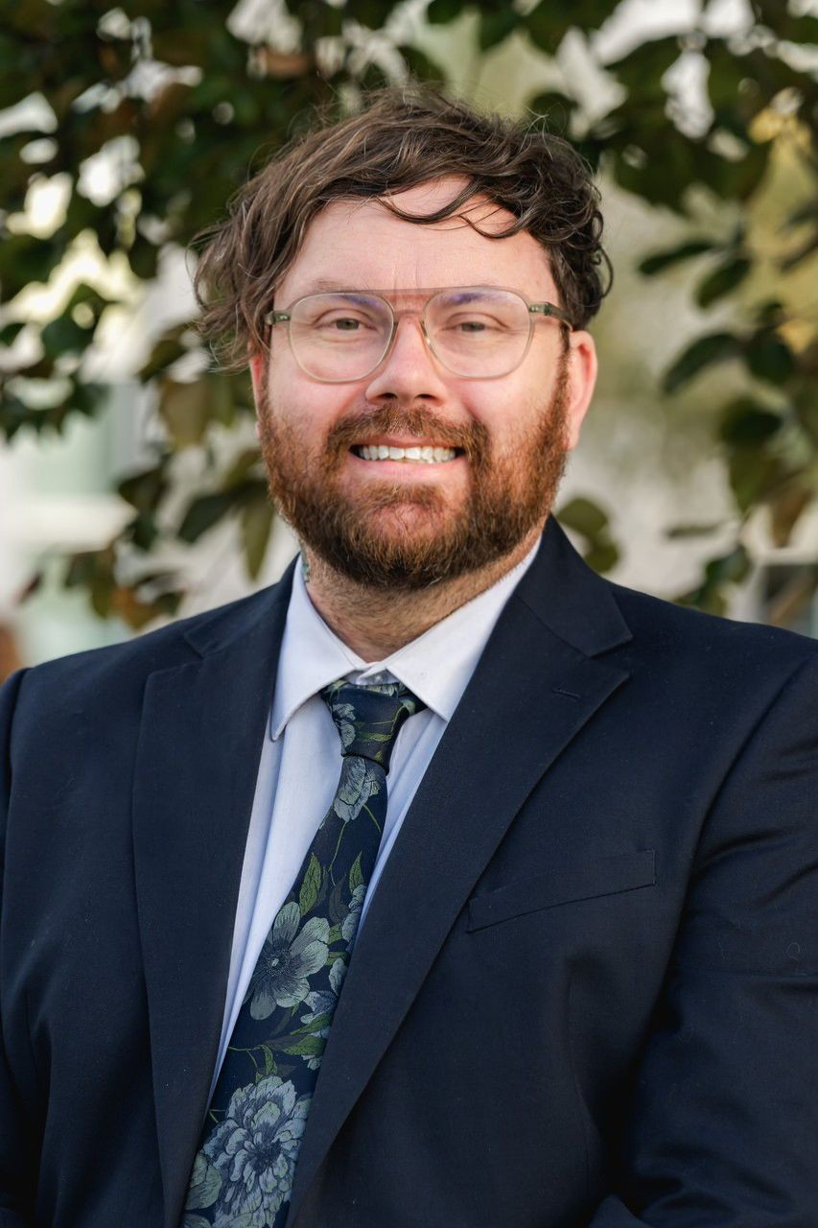
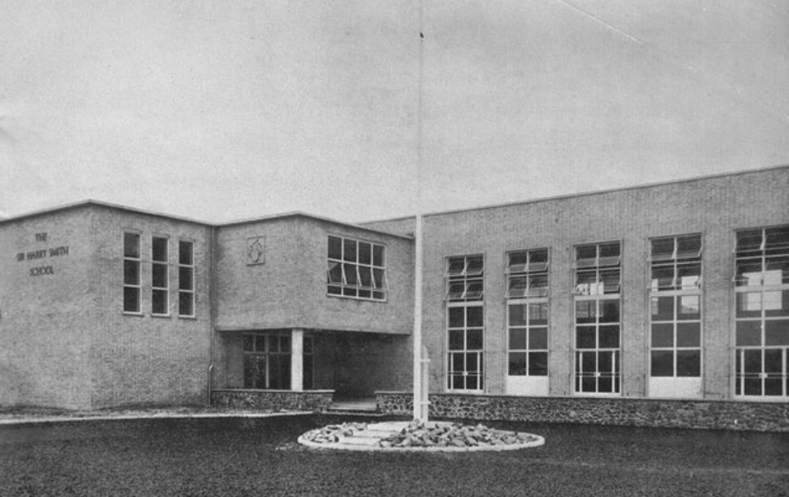
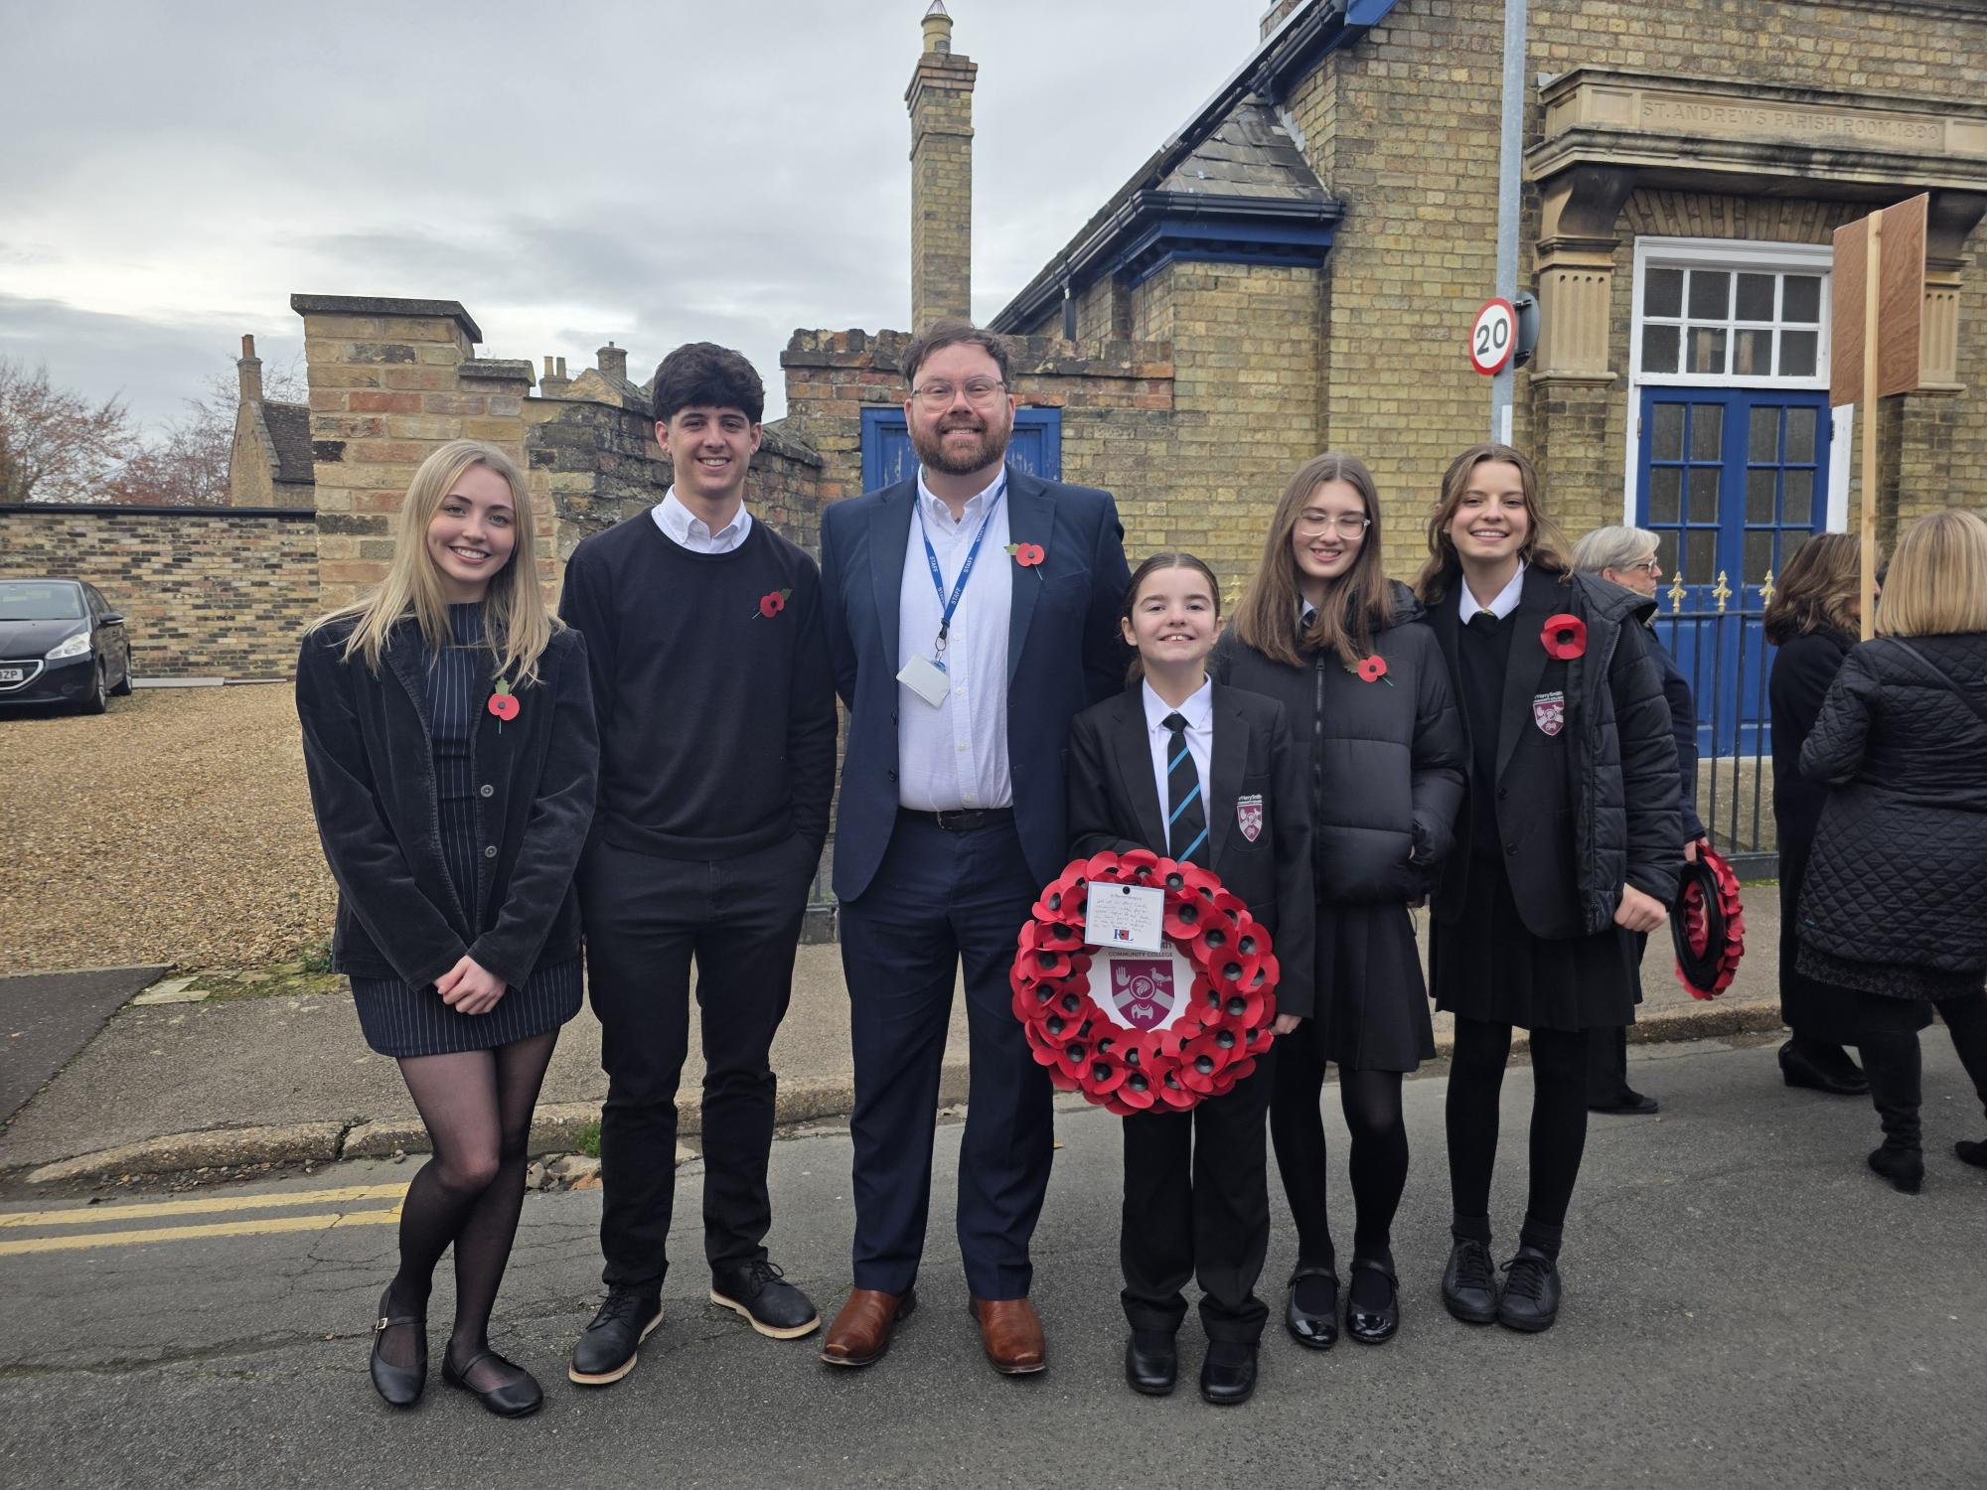
Communication
Community & Collaboration
Accountability
Safety
Attendance
Achievement
Enrichment
Aspiration & Achievement
Be Safe
Be Respectful
Be Responsible
Be Proud
1953
2025

Slide 5
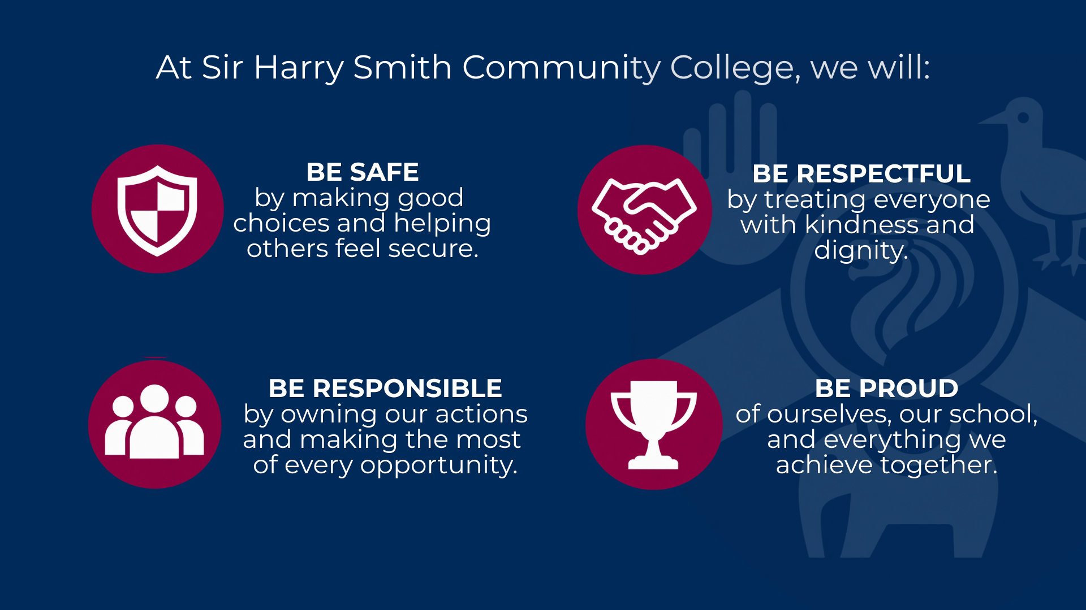

Slide 6
Meet Megan!

Slide 7
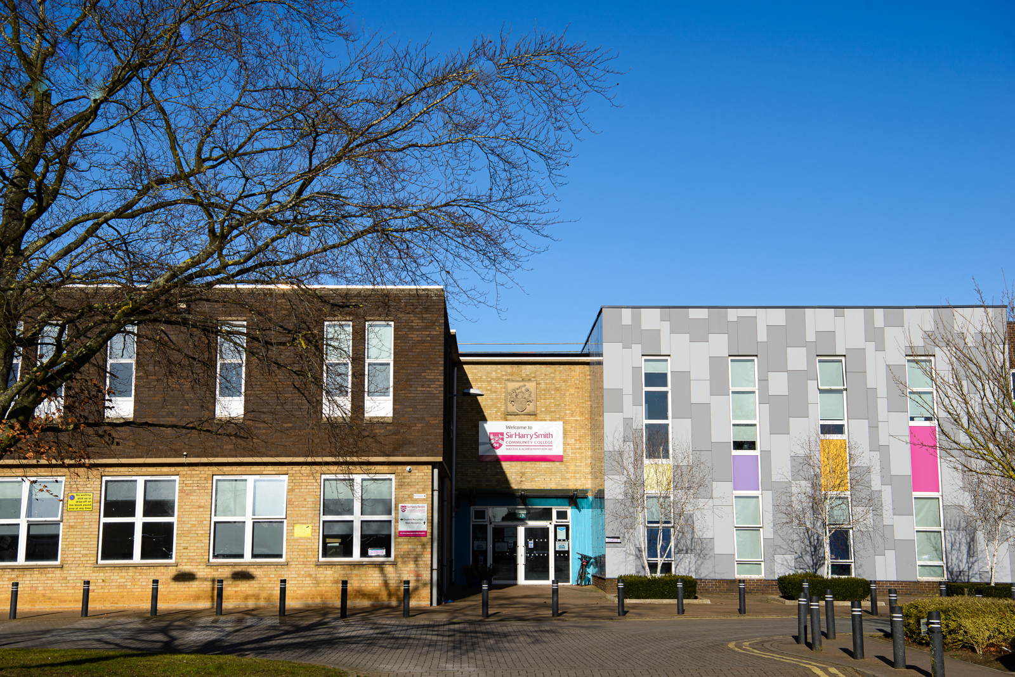
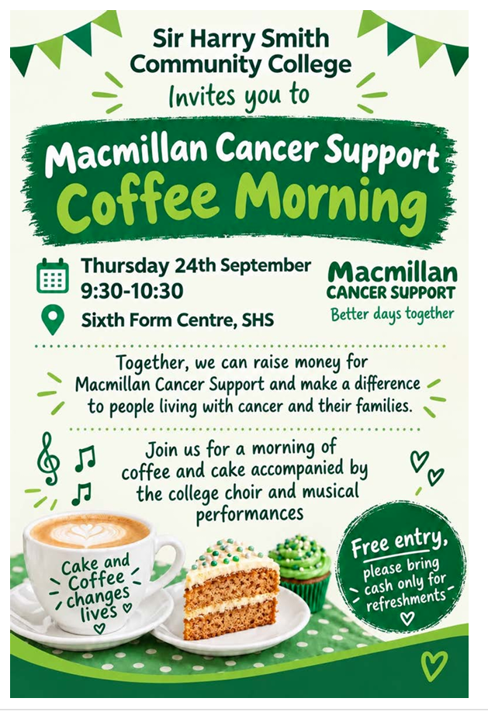
Community & Collaboration
Parent Forum
Our Parent Forum meets each half term to support college improvements and communication.
We’re always looking for new parents and carers to join us – refreshments provided!
Contact Ms Meadows for more information.
Headteacher’s tour
From Friday 16 October, parents, carers and prospective families can book a one-hour tour of the college.
Tour classrooms and facilities, meet staff and students, and ask any questions you may have.
Tours must be booked in advance with Ms Meadows.
Suggestions?
Have an idea to support our renewed focus on community engagement? We’d love to hear it.
Email suggestions@sirharrysmith.com. Suggestions are reviewed monthly by SLT.

Slide 8
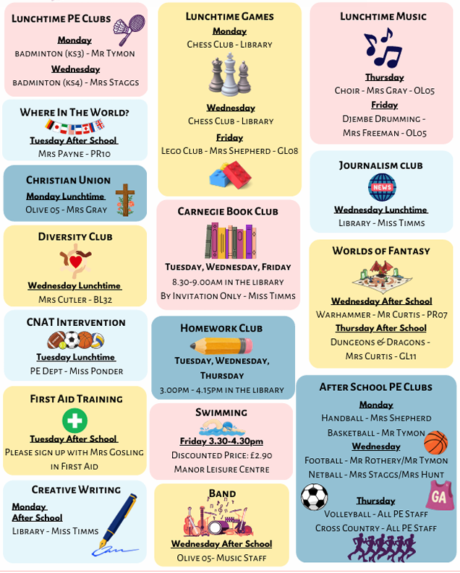

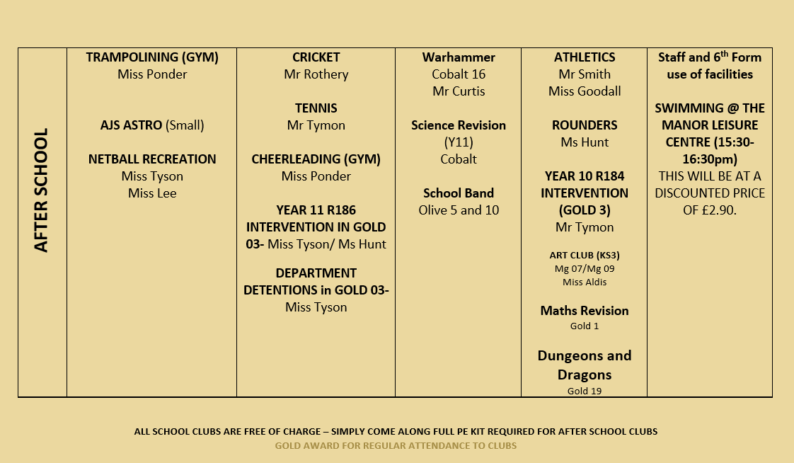

Slide 9
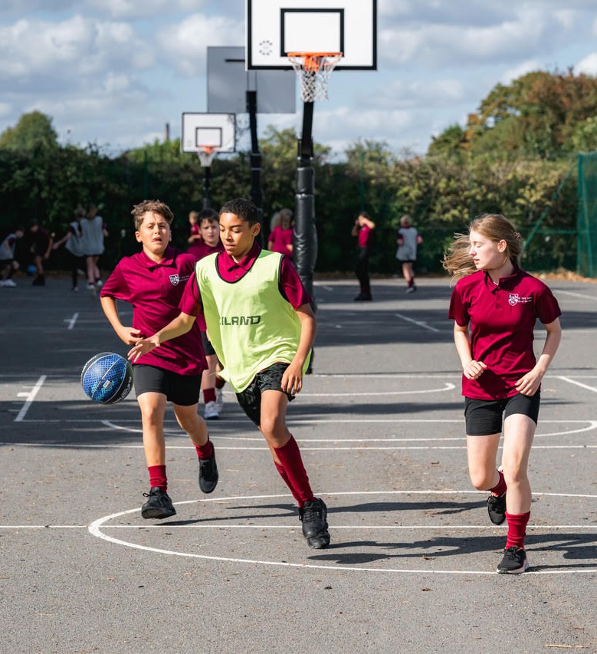
Enrichment: Future
Friday Afternoon Enrichment Programme
From this academic year, all students will take part in a dedicated Friday Afternoon Enrichment Programme with a choice of activities designed to build confidence, skills, interests and aspirations.
Activities will include:
Sport and physical activity
Arts, music and culture
Outdoor learning and adventure
Leadership and community projects
Careers, enterprise and life skills
Academic and special interest clubs

Slide 10
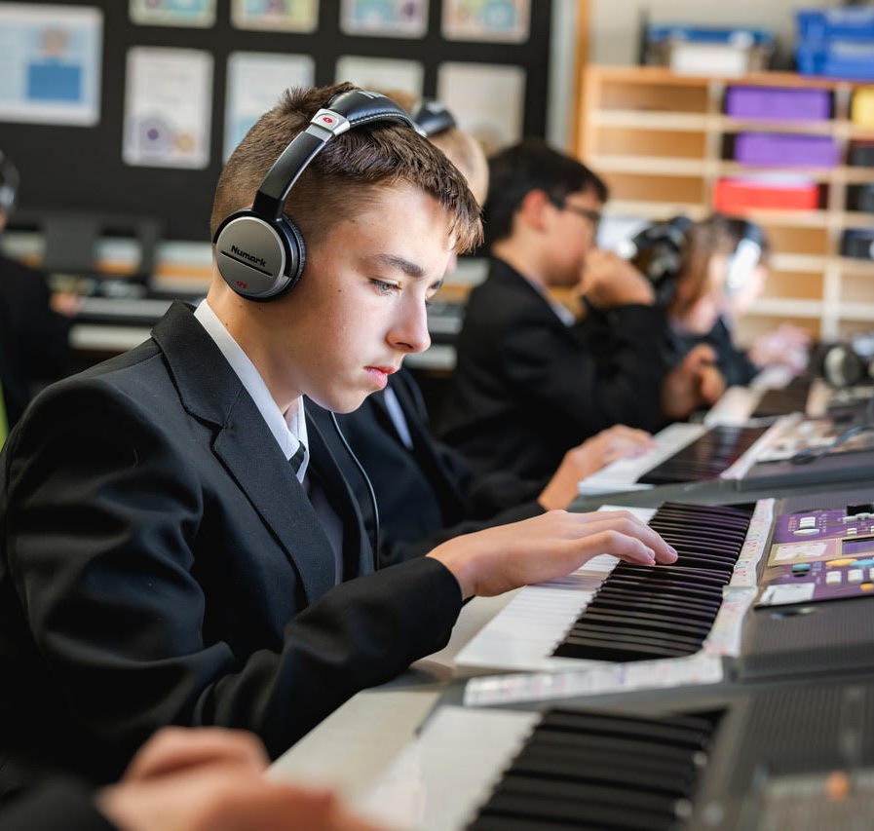
Friday TBC
08.30 – 09.00: Tutor time
09.00 – 09.50: P1
09.50 – 10.40: P2
10.40 – 11.00: Break
11.00 – 11.50 – P3
11.50 – 12.40 – P4
12.40 – 13.30 – P5
13.30 – 14.10 – Lunch
14.10 – 15.00 – Enrichment
NOTE: Y11 offered Study time instead of Enrichment
Our aim is for every student to discover new interests, build skills and friendships, and gain experiences that support their future.
Aligned with the Government’s Enrichment Framework, the programme will take place within the school day, ensuring every student has the opportunity to participate.
Further details about activities and how to choose them will be shared shortly.

Slide 11
Why
Sir Harry Smith Community College?

Slide 12
Small enough to know every child
Strong community values
Ambitious improvement journey
Dedicated staff
Investment in SEND provision
Broad enrichment opportunities
Clear behaviour expectations
Strong pastoral support
Partnership with parents
High aspirations for every student

