Slide 1
An introduction to Microsoft Teams
IMPORTANT:
DUE TO THE UNCERTAIN TIMES WE FIND OURSELVES IN DUE TO COVID 19 AND THE POSSIBILITY THAT SOME OR ALL STUDENTS WILL NOT BE ABLE TO COME INTO SCHOOL AND WILL NEED TO TAKE PART IN ONLINE LESSONS the college will use Microsoft teams as their remote/online learning platform.
THE COLLEGE WILL ALSO BE SWITCHING ALL HOMEWORK SET TO MICROSOFT TEAMS BY CHRISTMAS AND STUDENTS NEED TO BE FAMILIAR WITH USING TEAMS.
all login and passwords DETAILS FOR E-MAIL AND MICROSOFT TEAMS WILL be sent to parents/carers BY E-MAIL FROM THE E-MAIL ADDRESS lisa.newbatt@sirharrysmith.cambs.sch.uk .
Do not delete this email, please PASS THE DETAILS TO STUDENTS. we RECOMMEND THAT THEY SAVE THESE DETAILS SOMEWHERE WHERE THEY CAN ACEESS THEM. The password WILL never expires so it is impOrtaNt to keep it, as it will be thE Same username and password that student’s use for their entire time at the college.

Slide 2
Important information for login details and passwords to Microsoft Teams and School E-Mail.
All login and passwords will be sent to parents/carers via e-mail from the e-mail address lisa.newbatt@sirharrysmith.cambs.sch.uk
Do not delete this email but do keep it handy as there will not always be someone available to give you the information again.
The password set never expires so it is important to keep the e-mail as it will be the same username and password that student s use for their entire time at the college.

Slide 3
The basics
Please ensure you access and use Teams online via the school website and your school account.
Microsoft teams can be downloaded as an app on your phone, tablet or laptop/PC once you login to the school website. We recommend a laptop/PC as there have been issues getting online using phones and tablets. Please do this via the school website not Google as this will cause issues when trying to log on
As a student, all this is free for you.
It will be used to set homework for all years, by your teachers, by Christmas at the latest.
It can be used to give you feedback for any work you submit.
It can be used for online lessons for any years or students.

Slide 4
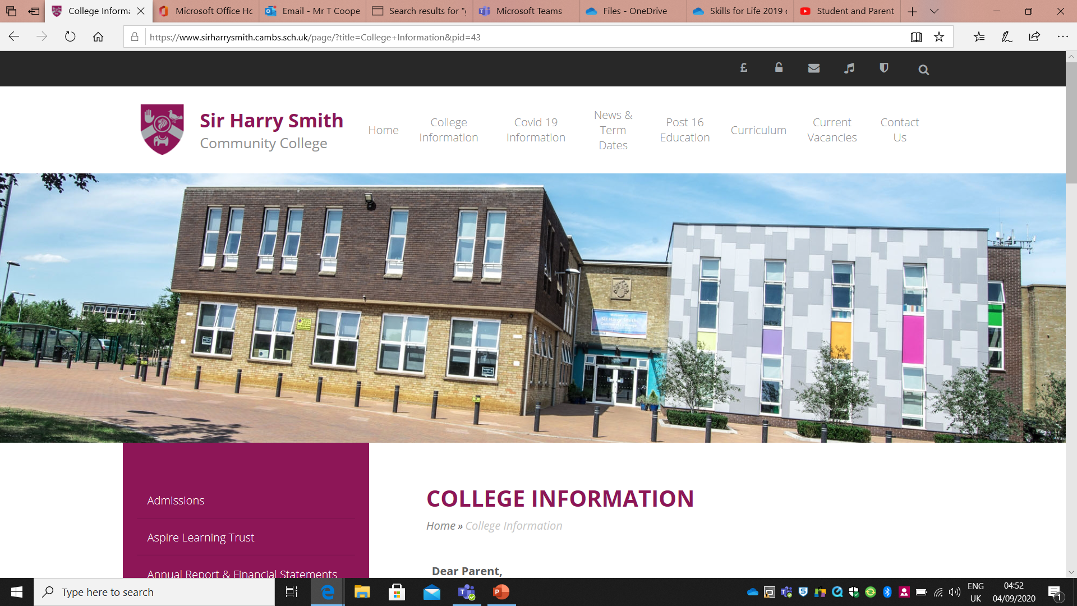
Log on to your school account via the school website

Slide 5
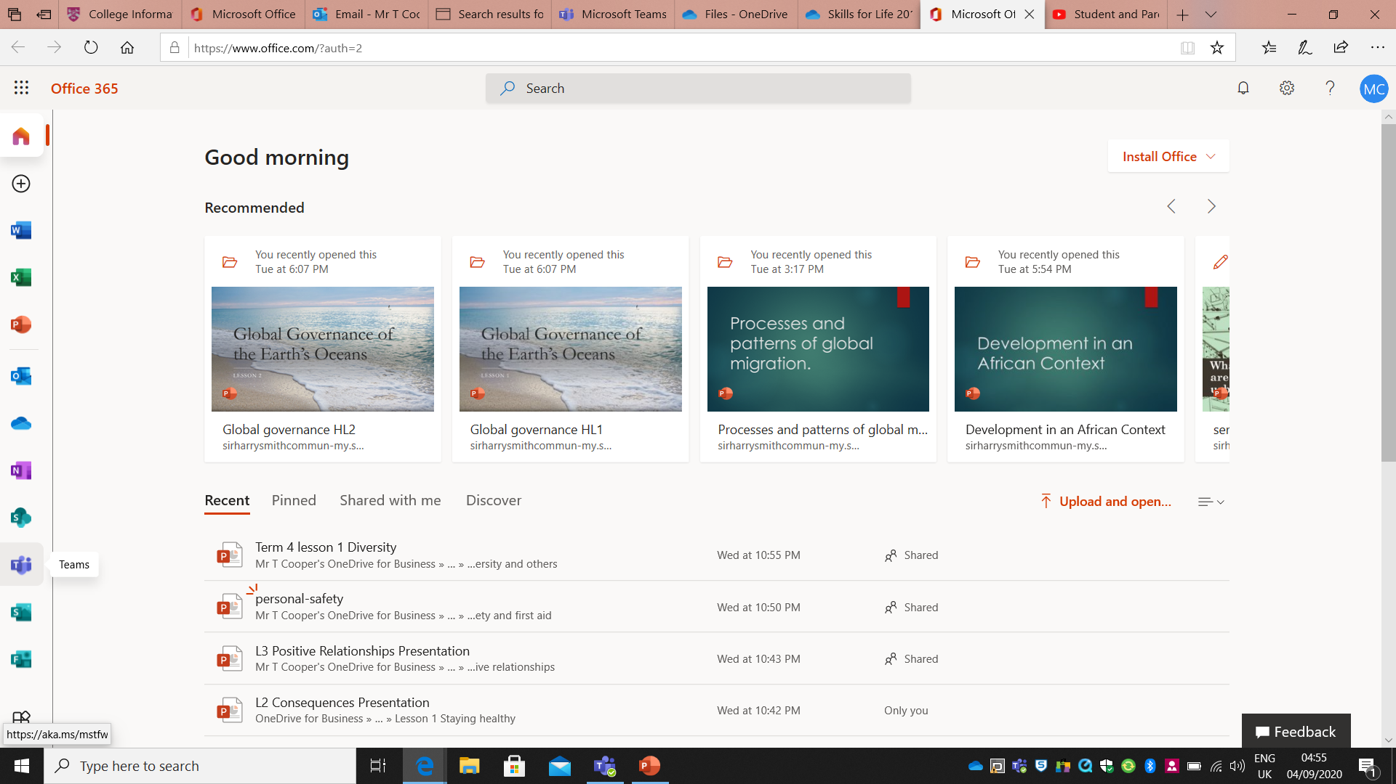
Once logged in, click on the Teams icon here to access Teams. Students also can download Microsoft Office 365 to their own Tablet\Laptop by clicking here

Slide 6
Watch the following video to see an introduction to Teams and how it works.
https://www.youtube.com/watch?v=SemjM2fHV2Q&app=desktop
Further information and guidance on using Teams can be found on the Microsoft website here:
https://support.microsoft.com/en-us/office/microsoft-teams-video-training-4f108e54-240b-4351-8084-b1089f0d21d7?ui=en-us&rs=en-us&ad=us

Slide 7
Just to go back over these points…
The next slides will go back over points made in the video.

Slide 8
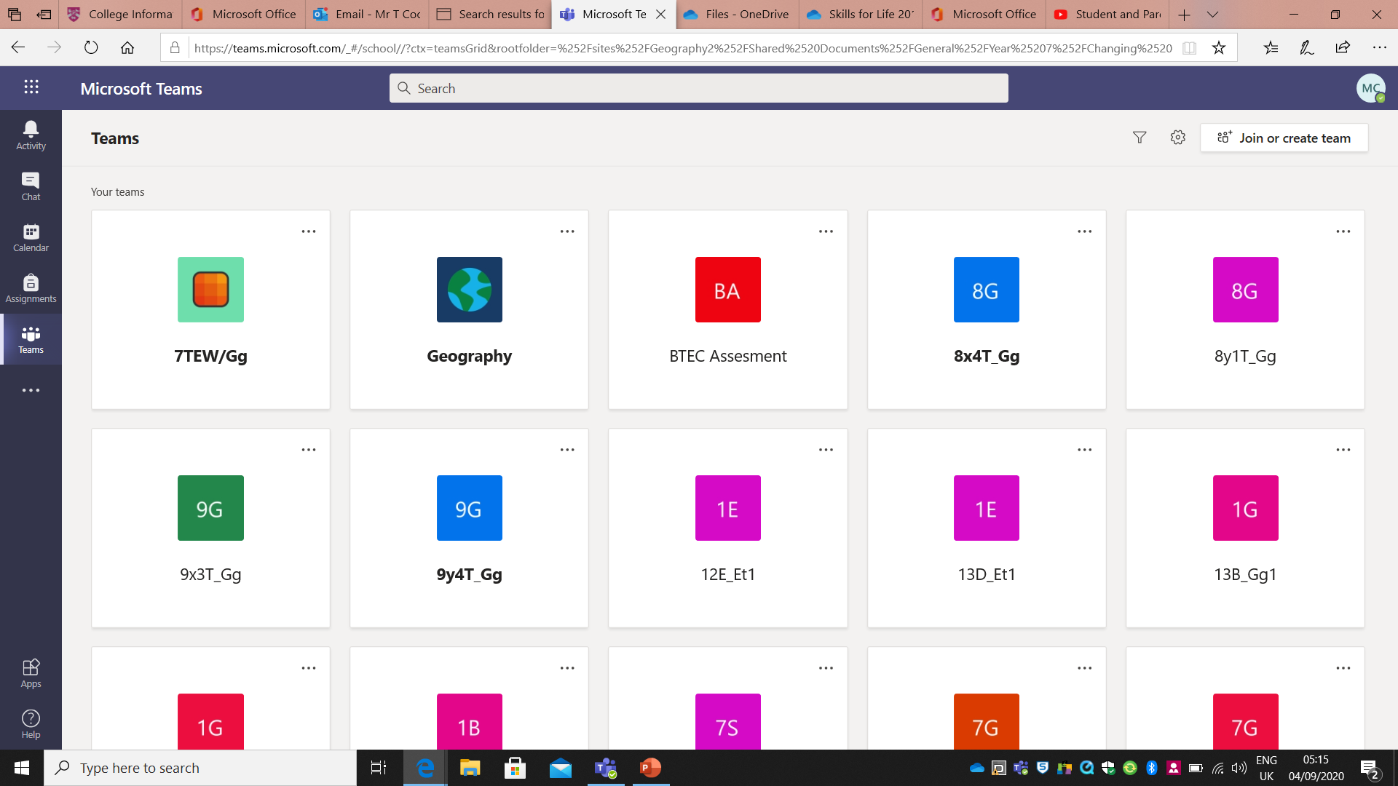
Your welcome screen has all your classes/Teams on with the menu on the right hand side

Slide 9
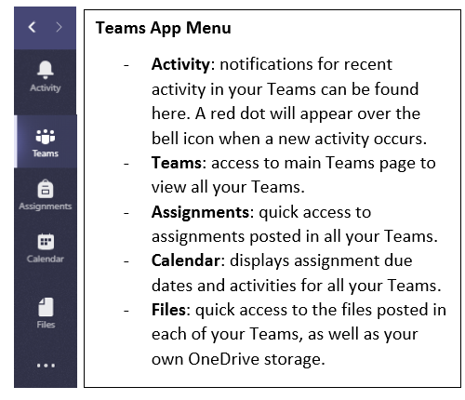
Click on Activity to see new items added or the calendar to see upcoming events like online lessons or assignments

Slide 10
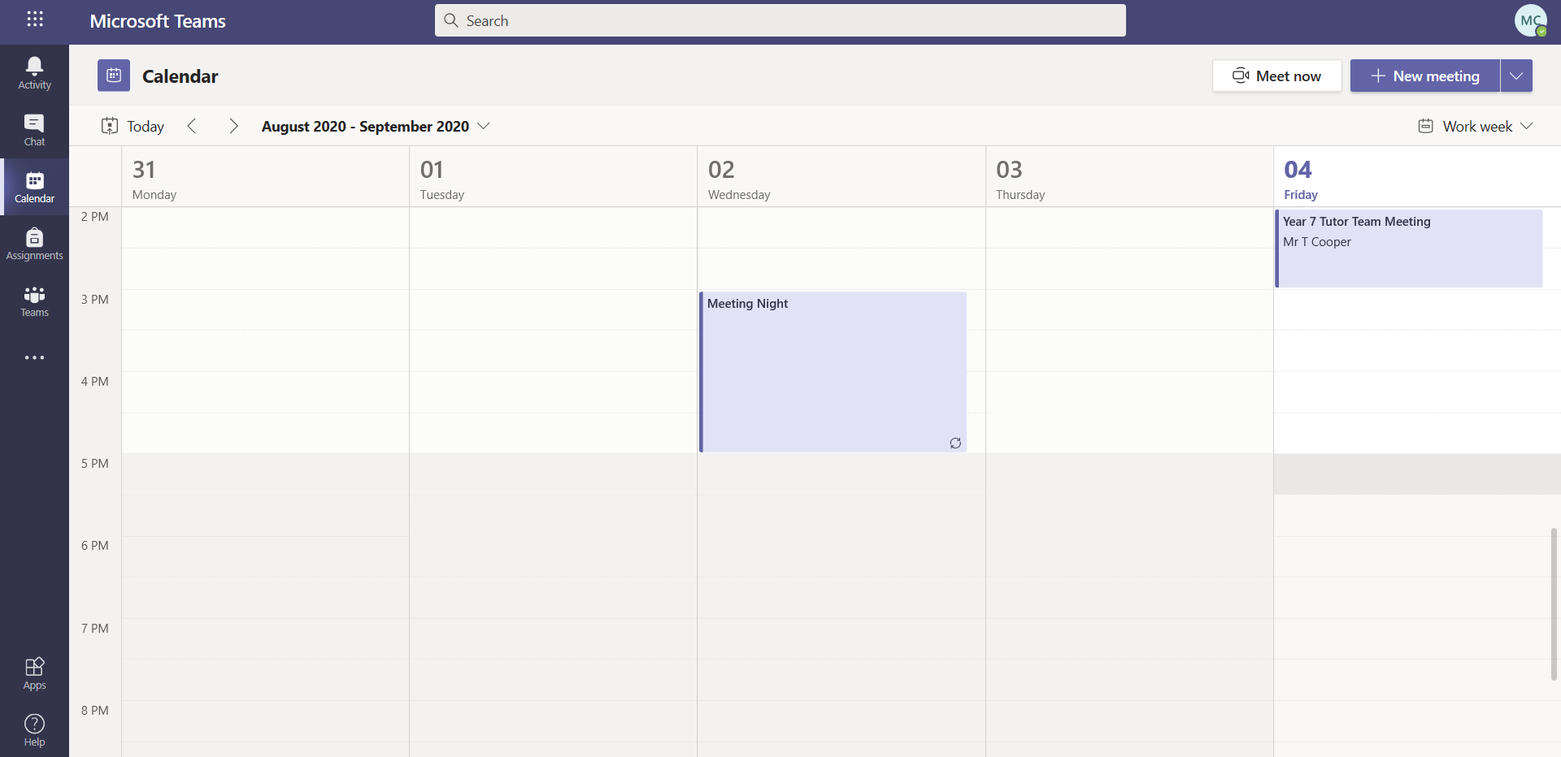
To join an online lesson, open the lesson event on your calendar. Homework or tasks due are also shown on your calendar here

Slide 11
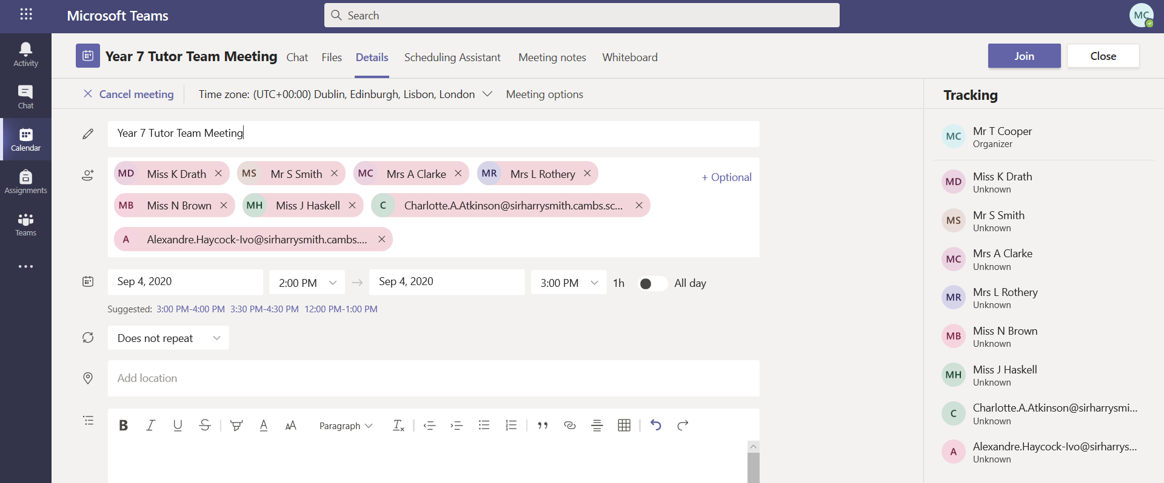
Then click join and follow the final instructions to join the meeting/lesson

Slide 12
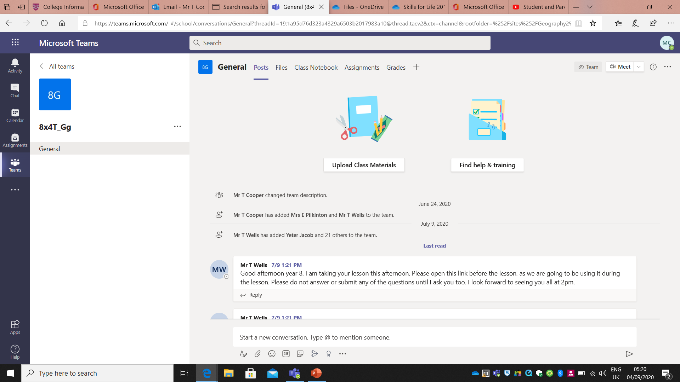
Open a particular Team and ensure you are on the General tab to see posts and assignments.

Slide 13
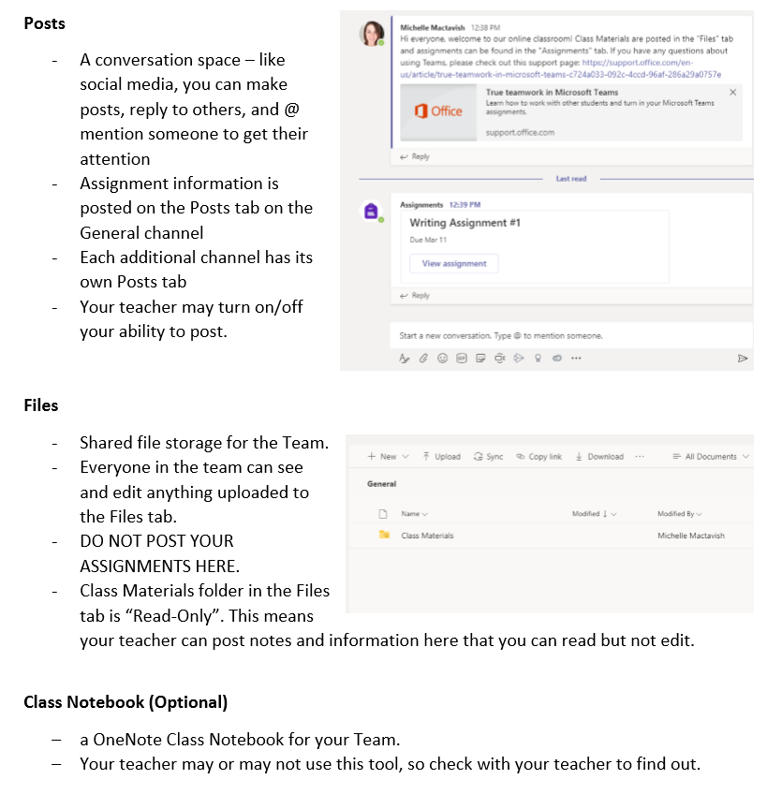
Open a particular Team and ensure you are on the General tab to see posts and assignments.

Slide 14
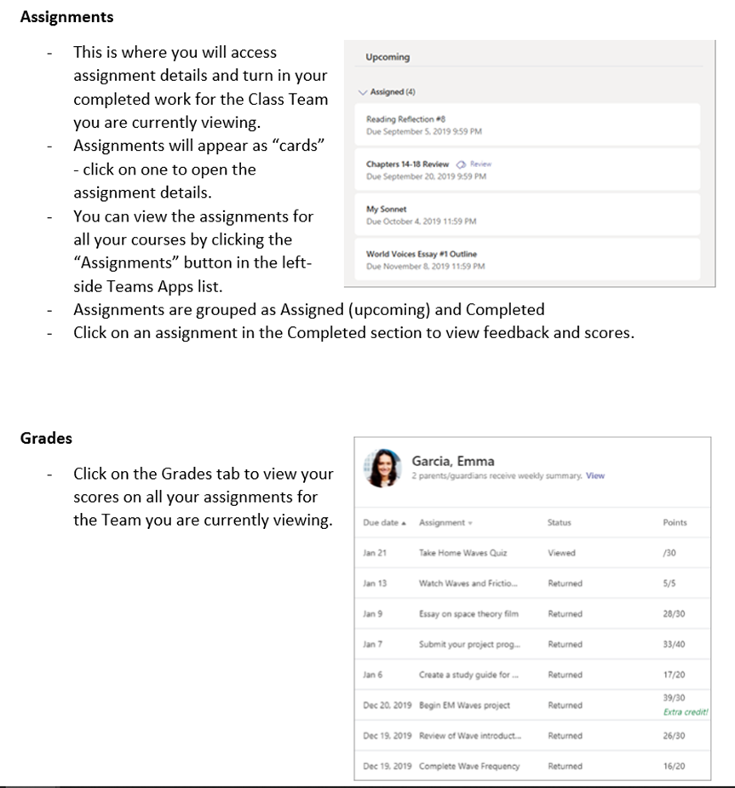
Open a particular Team and ensure you are on the General tab to see posts and assignments.

Slide 15
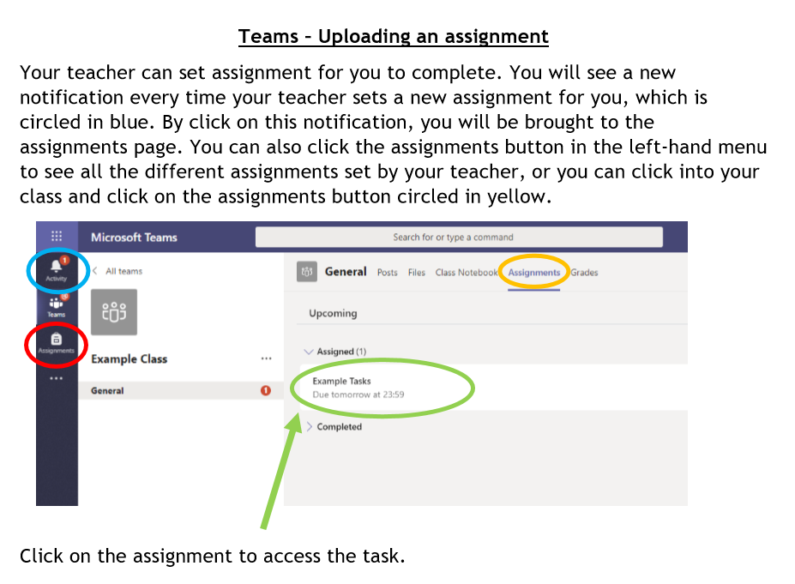

Slide 16
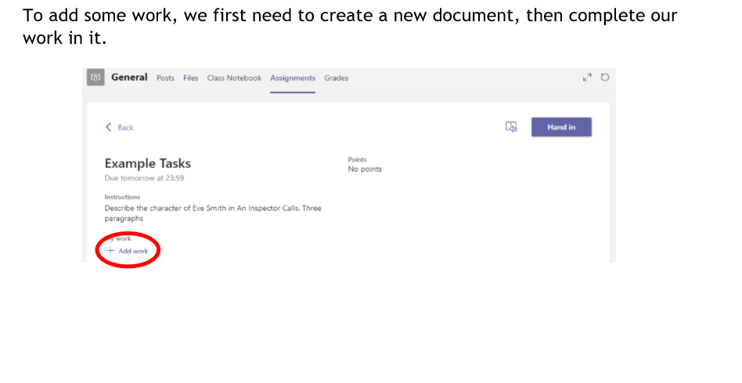

Slide 17
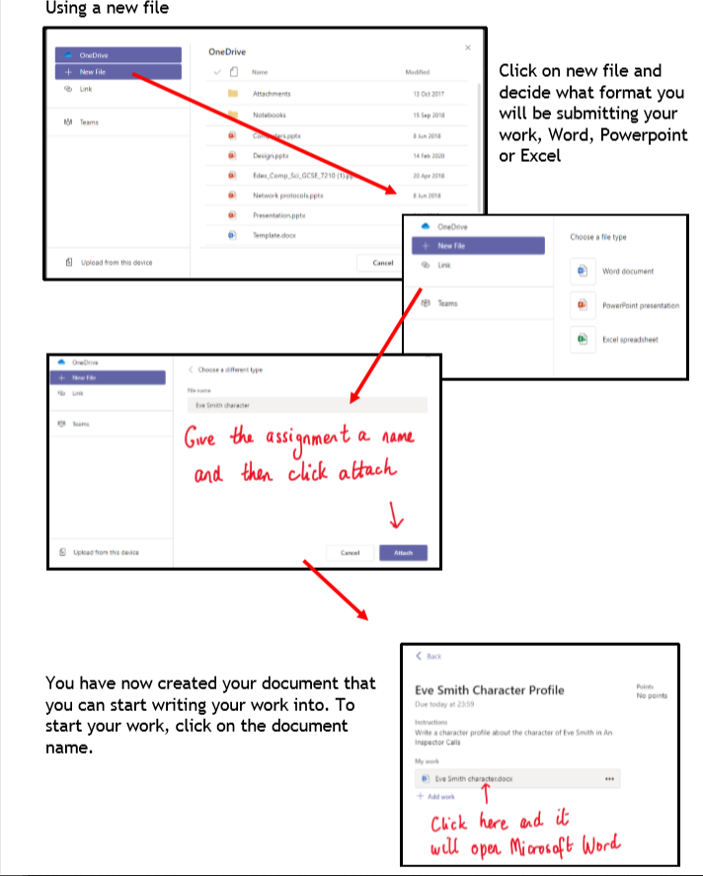
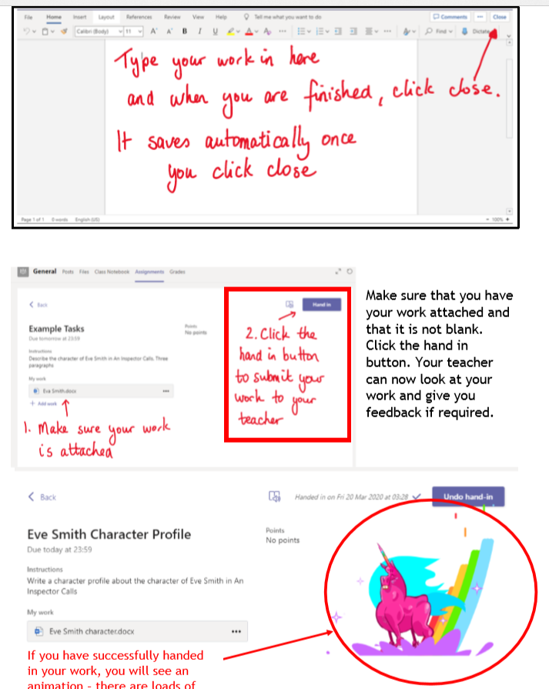

Slide 18
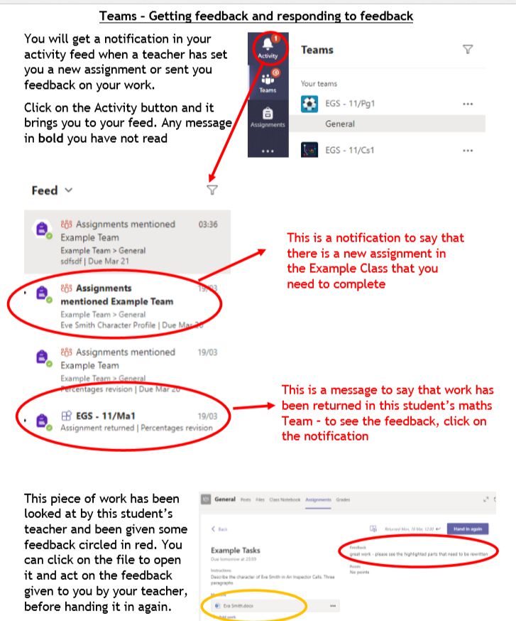

Slide 19
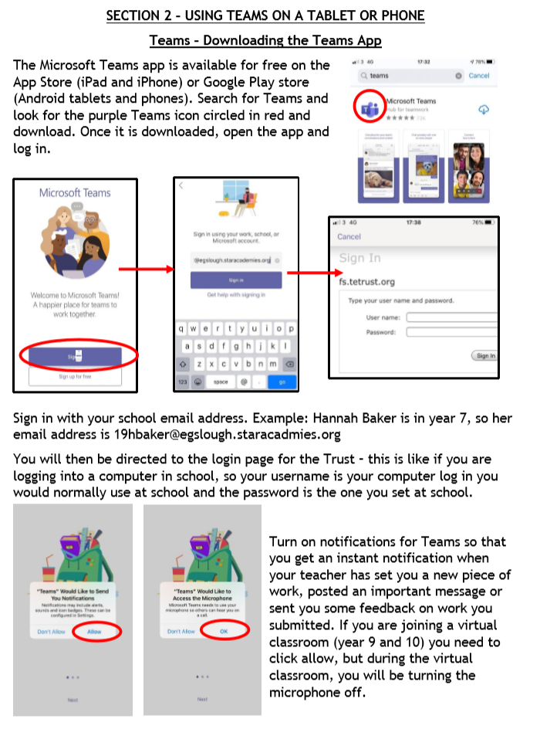
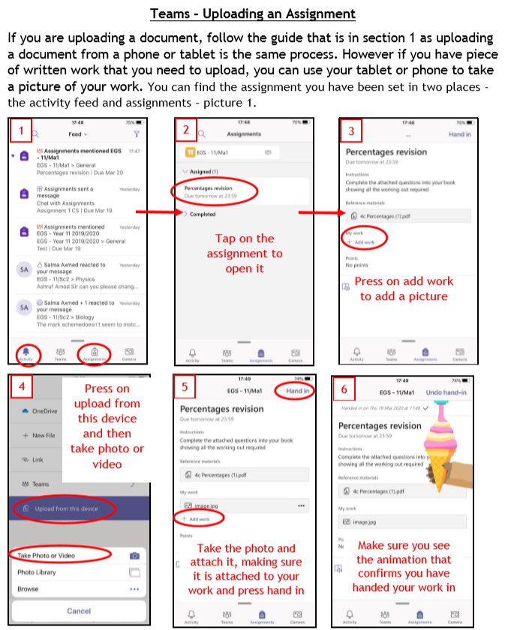

Slide 20

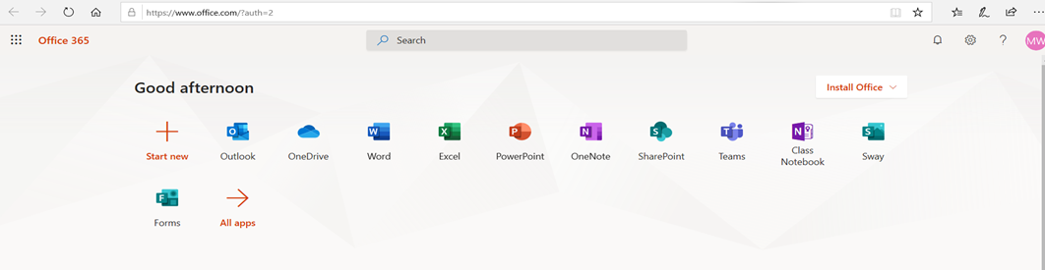
Using Teams for remote lessons.
Login as above via the school website, then click on the Teams icon shown below again

Slide 21
RULES for Online/Remote lessons
All students must be appropriately dressed and working in an appropriate space.
Video calls must not be recorded.
Microphones must be muted and cameras on if you have one.
All conversations must be appropriate and follow Sir Harry Smith Community College behaviour policy.
    Any of the above rules not adhered to will result in you being removed from Microsoft Teams and the consequences in line with the SHSCC behaviour policy.

Slide 22
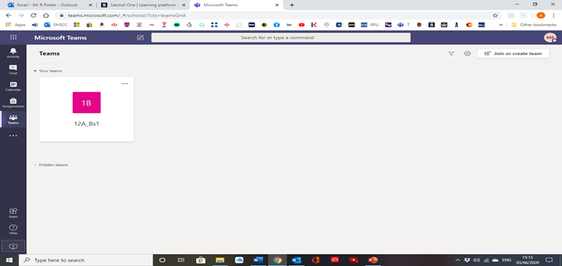
Using Microsoft teams
You will be informed of when your online session will take place and you will be invited by your teacher to attend (this will be the same time as one of your normal school timetabled lessons).
The invite will show in your calendar on Teams.
You will then see your teaching group and be able to access the session.

Slide 23
Using Microsoft teams
Click on your class ready for your session, where your teacher will be waiting to greet you.
Your mic must be muted (off) and your camera on (if you have one).
If you wish to ask a question during the session, please tap on the ‘hand’ sign which will indicate to your teacher that you wish to speak. You will then be asked to unmute your mic and ask your question.
Your session will last for between 30-60mins and at the end of the lesson you may leave.

Slide 24
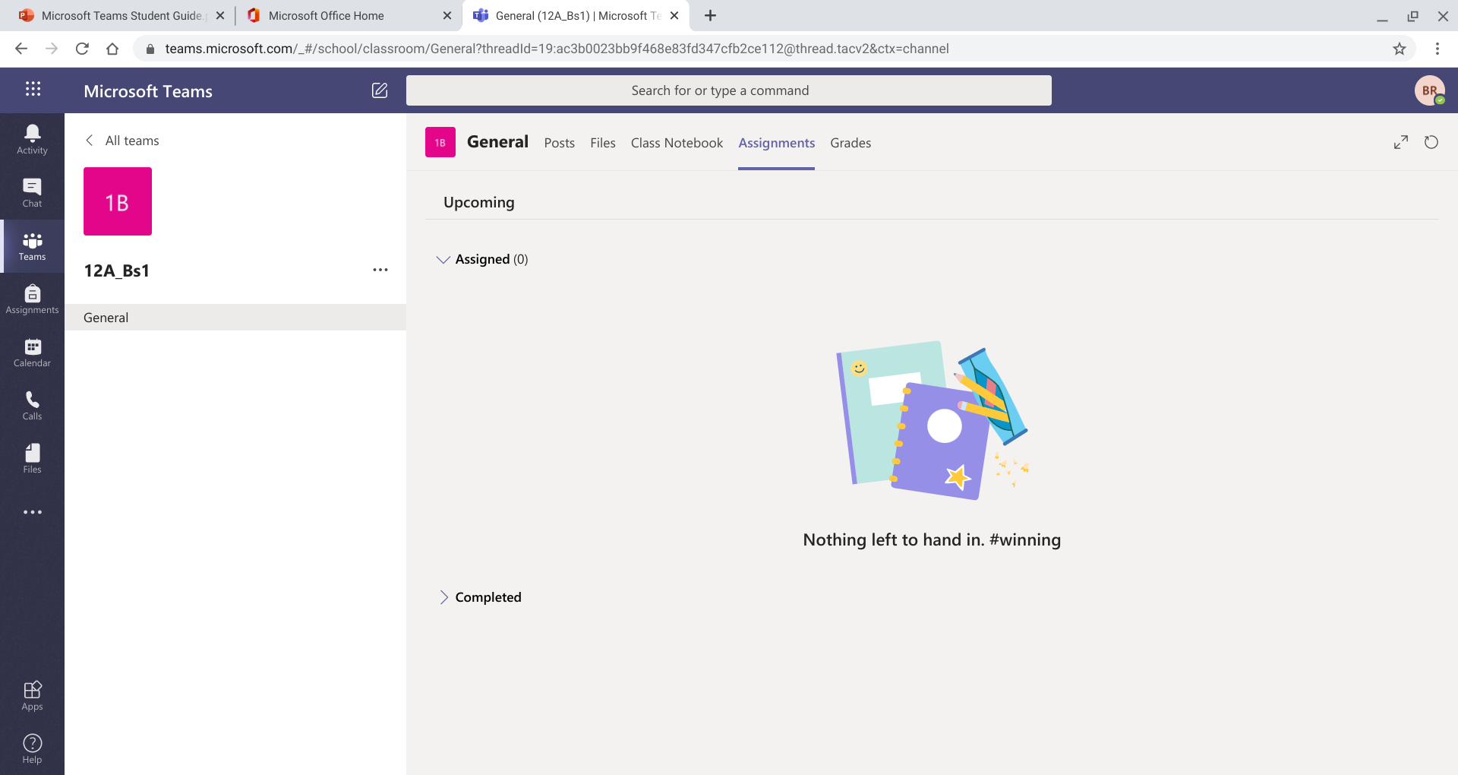
Assignment Tasks
Your teachers will still predominately use Show My Homework, but may want to assign you work before or after the lesson on Teams.
To access this click on ‘Teams' and along to ‘Assignments' where anything set will show up.

Slide 25
Troubleshooting
I can’t login
Use the student username and password sent to your parents/carers by e-mail.
Copy and paste the password from the e-mail as a common mistake is to mix up capital I for Indigo with small l for Lima.
Ensure all other users are logged out of Office 365 or Teams. Many people have these applications and sign into them automatically, but it will only allow one person to log on at a time.
My Account is locked.
Wait 5 minutes and it will automatically unlock.
I need my password resetting.
You don’t, the password sent to parents/carers doesn’t ever expire. If you click on the reset my password button, it doesn’t work, it is a dead button, because your password never expires. No message will be sent and no one will look at this. Use the username and password sent out.
If after trying all of the above you are still experiencing difficulties in accessing your school account online and Teams online please contact us on password.reset@sirharrysmith.cambs.sch.uk

