Slide 1


R051 Values in Sport
Values in sport

Slide 2
LO2 – Know about the role of sport in promoting values
This is all about you understanding the values sport promotes including the Olympic and Paralympic values.
Understanding what a sporting initiative is and some examples.
Sporting etiquette both of players and supporters.
The use of performance enhancing drugs

Slide 3




Values
Principles or standards of behaviour, a judgement on what is important.

Slide 4
Task 1
Create a mind map with the word values in the middle.
Write down as many values that you can think of which might be developed through sport.
Notes:
Write the groups on the whiteboard.

Slide 5
Values that can be promoted through sport
Forget Netflix it’s all about…
NETFICT
National Pride
Excellence
Team spirit
Fair play
Inclusion
Citizenship
Tolerance and Respect

Slide 6
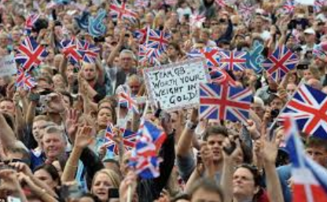
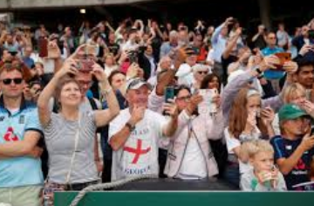
National Pride
Sport develops a sense of pride in the name, culture and practices of a country. Shown when supporters and performers unite behind their country in international events. World cups/Euros/Olympics/Paralympics
E.g. singing the national anthem or wearing certain colours. Think carefully when using this one as an answer in the exam. Only applies to national success.

Slide 7
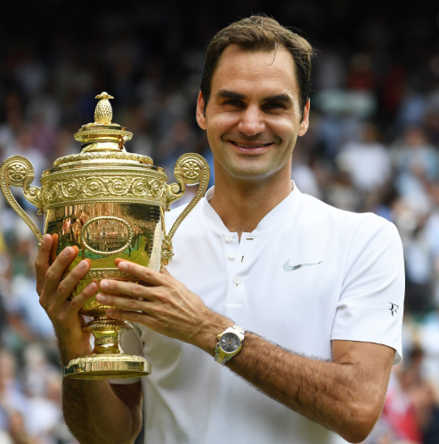
Excellence
Encourages people to strive to be the best they can be.
For example trying to constantly improve in your favourite sport.
All the professional athletes you see had to start the sport at some point and have continued to practice to get better and become professional.
Even when professional they continue to train daily to continue to improve.
Notes:
RF – at the time of writing won 20 major grand slams – the most of any male tennis player ever.

Slide 8
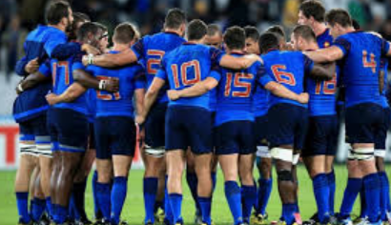
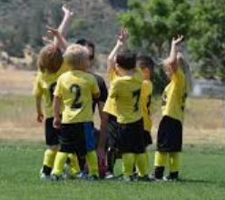
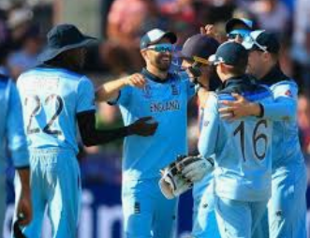
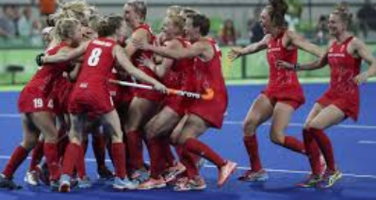
Team Spirit
Allows performers to gain a feeling of pride and loyalty that exists among the team which makes them want to do well for the team.
All have pride in each others performance will contribute to the overall performance of the team.
They will work well together and be successful.
For example championship winning teams.
Think about how many of you play FIFA or football manager and you have to get the team chemistry/team morale up. This is what this is in real life.

Slide 9
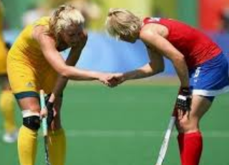
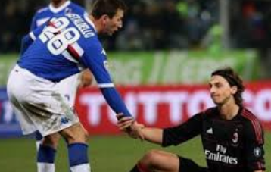
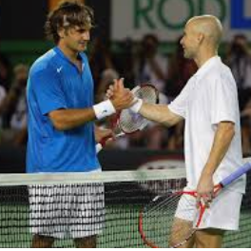
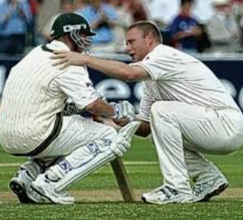
Fair Play
Sport allows performers to show fair play.
This is appropriate, polite behaviour which involves respect for fellow competitors and adhering to rules and does not involve doping.
For example respecting an opponent putting in golf. Being honest if you made a catch or if it hit the floor.
Lots of examples of sportsmanship.

Slide 10
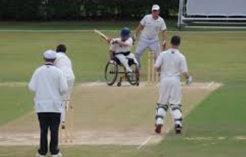
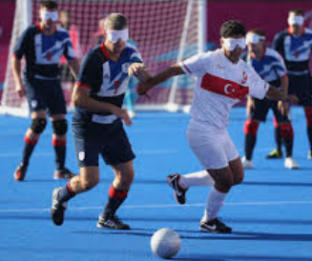
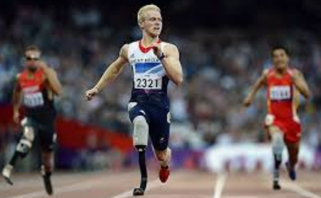
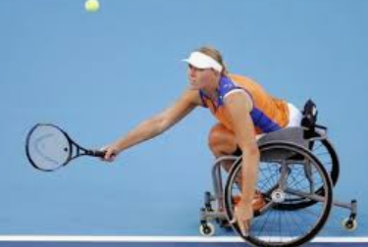
Inclusion
Sport can allow people to be included within teams, competitions or structures.
This can include campaigns/initiatives to encourage under-represented social groups in sport.
For example the Paralympics.

Slide 11
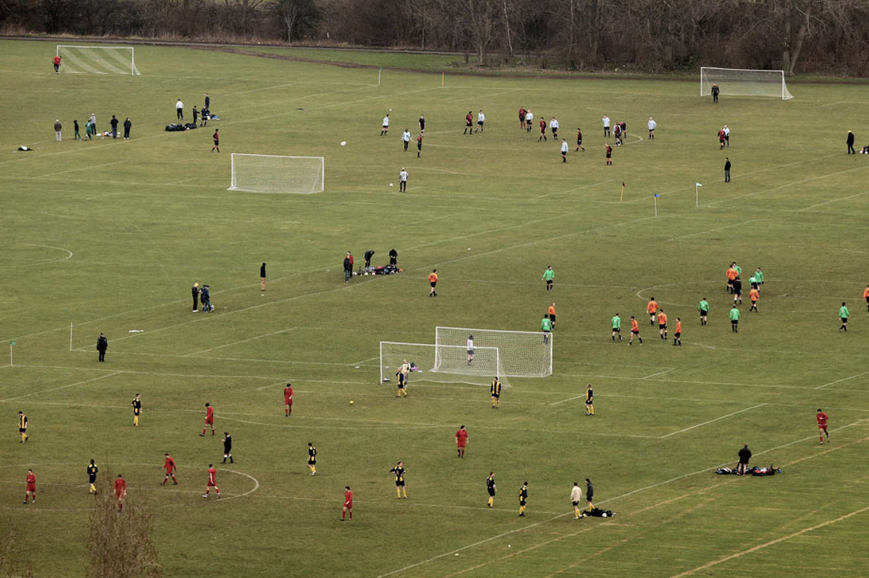
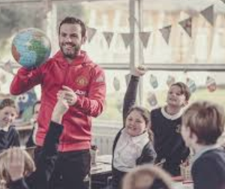
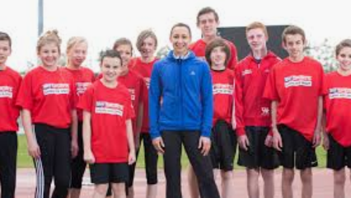
Citizenship
Sport can allow people to act as good citizens.
Act in the same way that citizens should.
For example getting involved in the local community through sport.

Slide 12
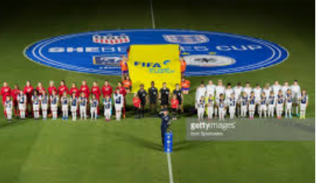
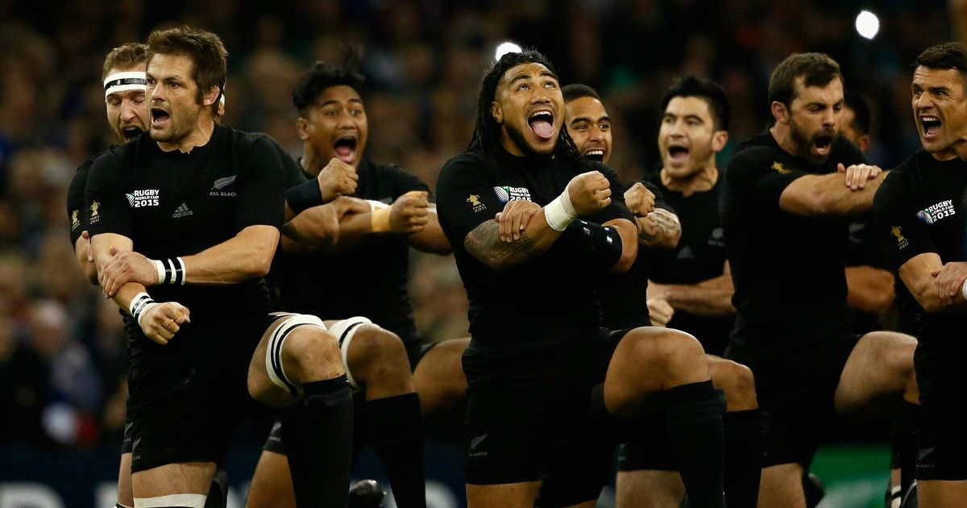
Tolerance and Respect
Sport can help performers to tolerate and understand others.
Allows them to show respect to others.
A willingness to respect the differences of others.
Respecting the anthems of other countries, the different cultures. Learning about these cultures through sport.

Slide 13
Task 2
Make sure you have a brief description of each value.
Write down an example of when you have shown each value in sport or witnessed each value being shown in sport. Write down an example for each value.

Slide 14
Task 3
What do you think about the values?
Which 3 do you think are the most important? (you can only pick 3)
Write down why you think these are the most important

Slide 15
Olympics
https://www.youtube.com/watch?v=gKJDjg4ebNQ

Slide 16
The Olympic and Paralympic Movements
Both aim to represent similar core values. We will look at these later.
Held once every 4 years in the same host city.
Key terms
  Olympic creed
  Olympic symbol
  Olympic and Paralympic values

Slide 17
The Olympic and Paralympic Values
Olympic
  Friendship
  Respect
  Excellence
Paralympics
  Determination
  Inspiration
  Courage
  Equality
Notes:
REF and DICE

Slide 18
Task 4
Find a definition for each of the key terms
These must be in the types of detail that make it easy for you to understand

Slide 19
Task5
Create a poster/leaflet that promotes Sporting/ Olympic and Paralympic games.
Treat it as if it is a brand new, nobody has any idea about. Inform us all what it is!!

Slide 20
Task 6
Create top trump cards for the top athletes of your choice.
Make sure you put a range of scores so the game flows well. When complete play with family.

