Slide 1
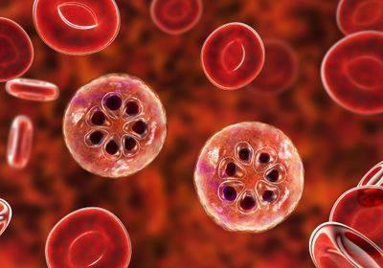
Rosie Tuffin
Malaria infected Red Blood Cells
Julian Rayner’s lab

Slide 2
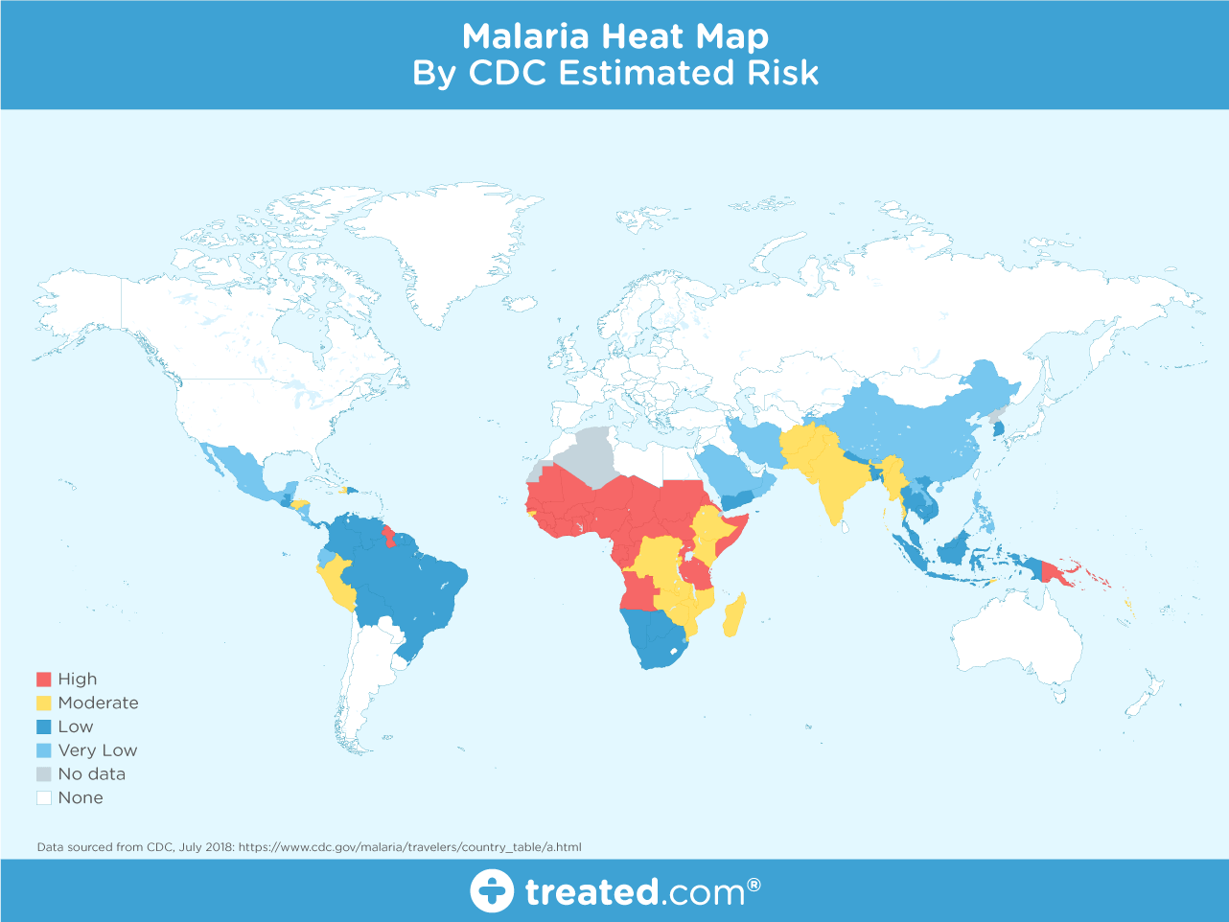
Background of malaria
241 million cases in 2020, 627,000 deaths.
Every 2 minutes a child under 5 dies.
Malaria is caused by Plasmodium species; Plasmodium falciparum is responsible for the most deaths.
It is carried via mosquitos and then transmitted into the human blood stream.
They enter the red blood cells by using proteins, which bind to the surface and allow infiltration.
The Plasmodium multiply within cell, until bursting out, killing cells.
There it can travel around the body causing high fever, shaking and flu-like symptoms.

Slide 3
Day-to-day work of the lab
Research into trying to find a vaccine for malaria
Finding a vaccine is difficult since malaria has so many proteins that it can use to enter red blood cells, it’s hard to find the exact amount needing to be targeted.
By trying to find how many antibodies need to be found to fight off malaria, can attempt to make a vaccine
Have attempted to delete a gene important to parasite invasion.
The experiment will take the parasite dna, and try and check whether the gene has been deleted, using sequence specific primers.
Hypothetically, the wild-type primer will recognise the wild-type dna and the edited primer will recognise the edited dna.

Slide 4
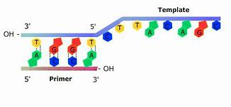
The experiment:
Day-1
We took 2 types of 181 gene, wild and edited, to produce 6 mixes from 2 master mixes both containing clone amp master mix, and reverse primers and water.
3 mixes contained wild primers, 3 contained edited primers.
added DNA
Tested 2 with Wild DNA and 2 with edited DNA and a control of water for the remaining.
We ran the 6 tubes through a PCR machine for 30 cycles, heating and cooling the DNA to replicate and amplify it.

Slide 5
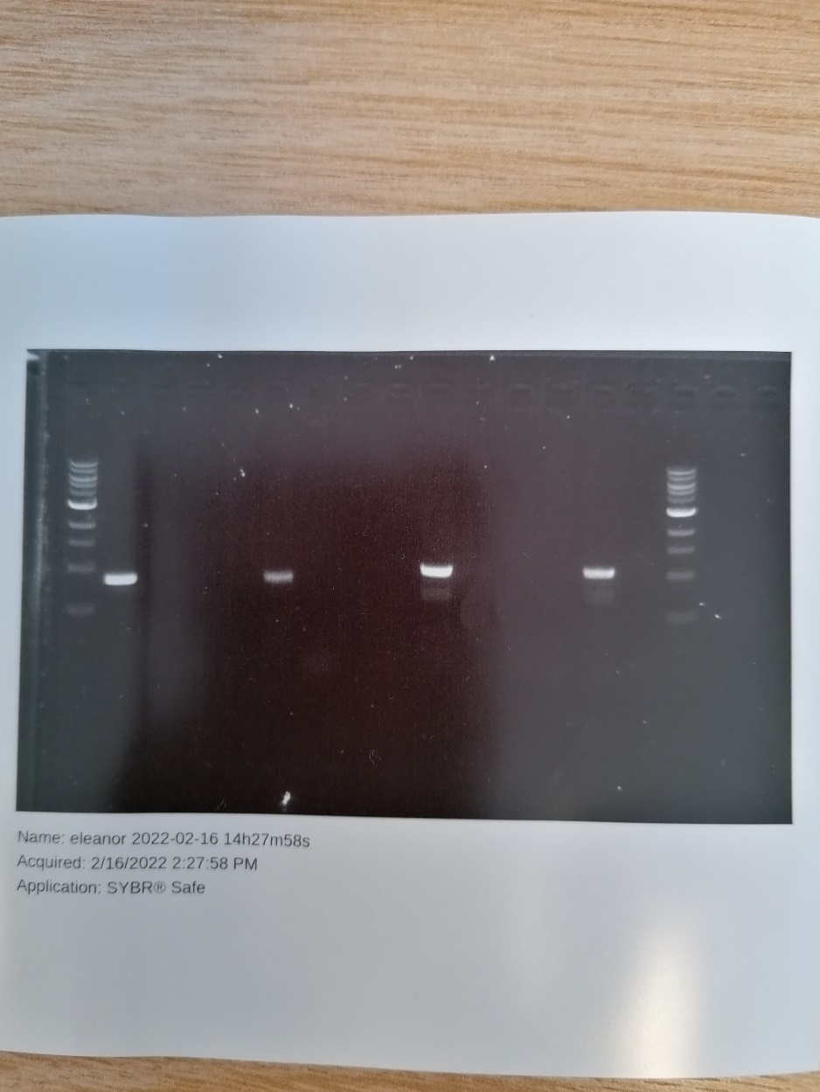
The experiment: day-2
Set up an agarose gel, containing dye that binds to DNA which shows under UV light and a comb to produce wells for the mixes. Allowed to cool.
Added 2 microliters of dye to all 6 of the DNA-containing tubes, so will show up in the gel.
Placed the gel into a gel electrophoresis and added all the mixtures into individual wells and left to travel to the positive terminal.
Then removed gel and placed under a trans illuminator to pick up the fluorescence being shown and imaged.

Slide 6
What I have learned
From the experiment
From the ISAC programme
Learnt how PCRS work
Benefiting research into malaria
Apply this knowledge into more commonly encountered Covid testing
1) how proteins are discovered and imaged
2) the importance of potassium in the body and the research being put in to strive for a more comfortable day to day life of those suffering from it.
3) gained first hand experience of working in a lab, and insight into the process of going about doing experiments.

